Slide 1
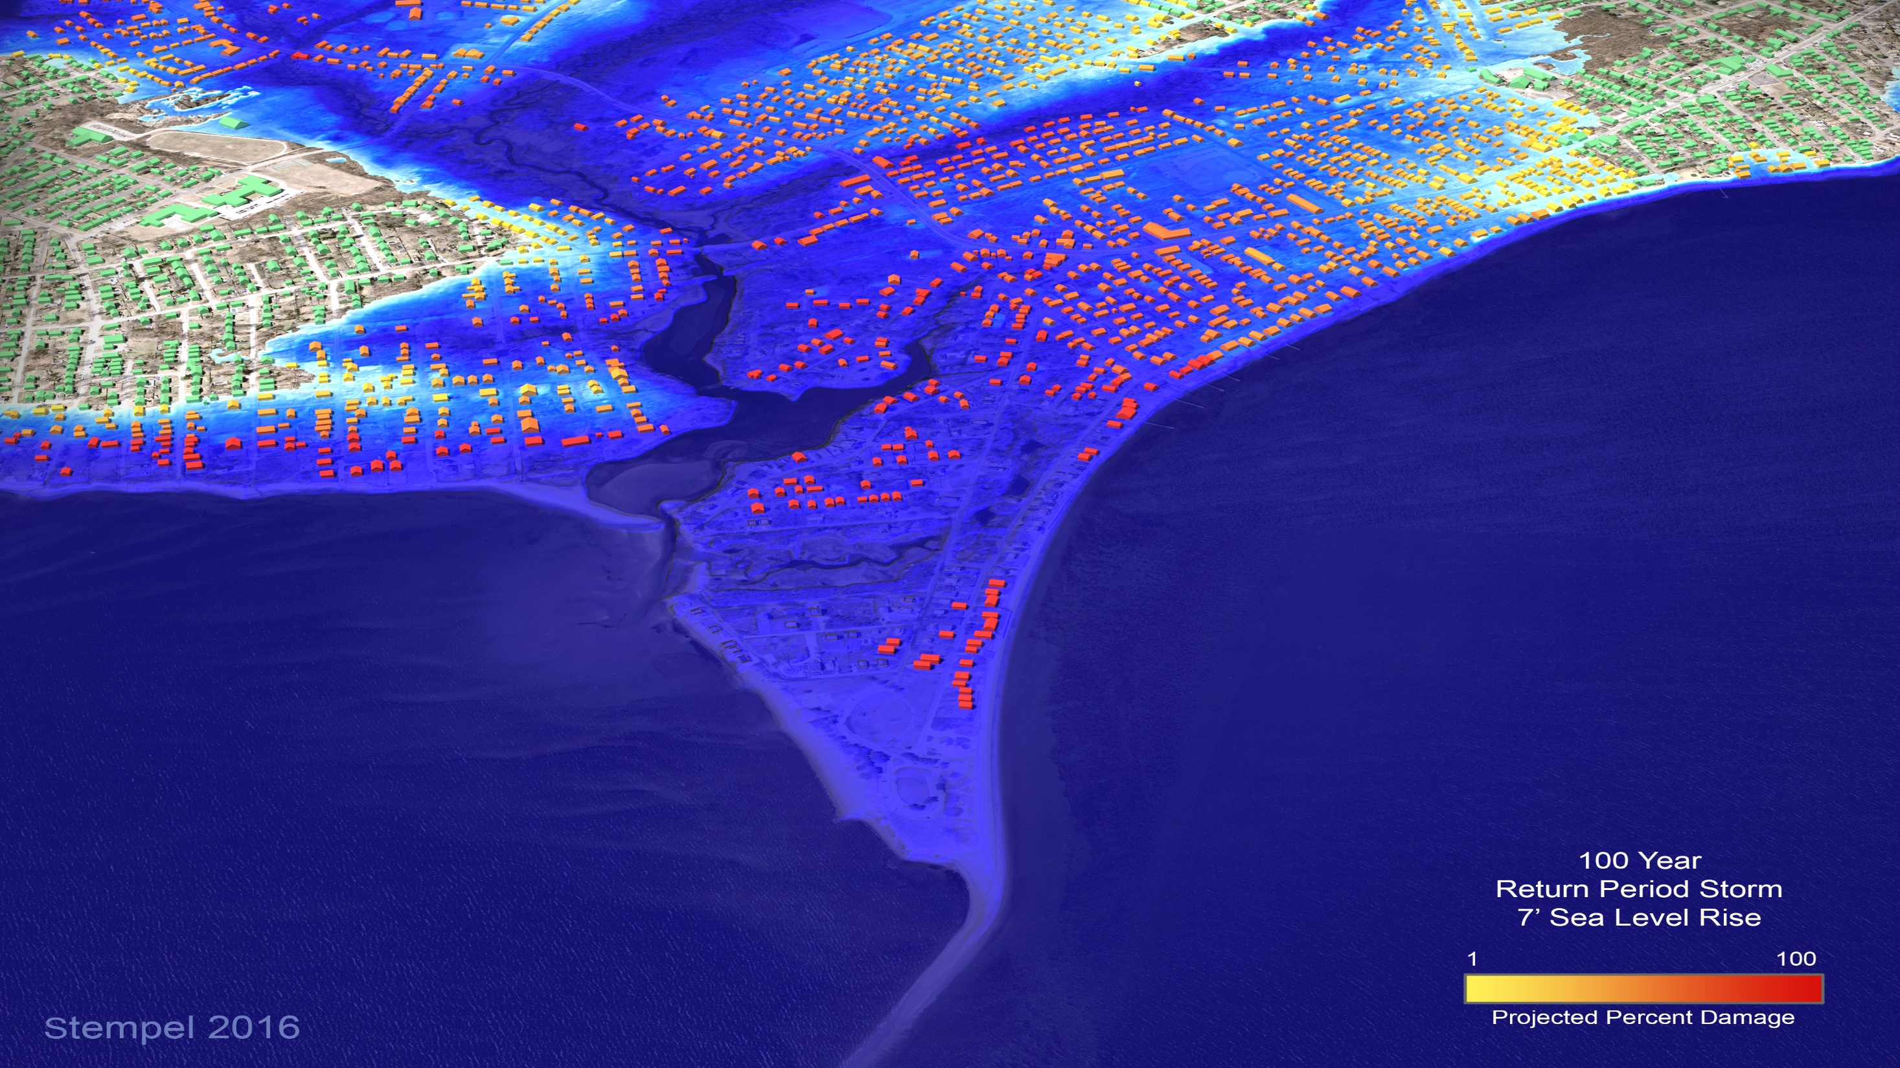
STORMTOOLS Overview: Flooding, Coastal Environmental Risk Index, and Design Elevation Maps
Malcolm L. Spaulding and team*
*Annette Grilli, Chris Damon, Teresa Crean, Grover Fugate, Jim Boyd, Janet Freedman, and Reza Hashemi
Ocean Engineering, University of RI, Narragansett, RI;
STORMTOOLS Design Elevation Map
Training Sessions
Oct 24 and Nov 9, 2018

Slide 2
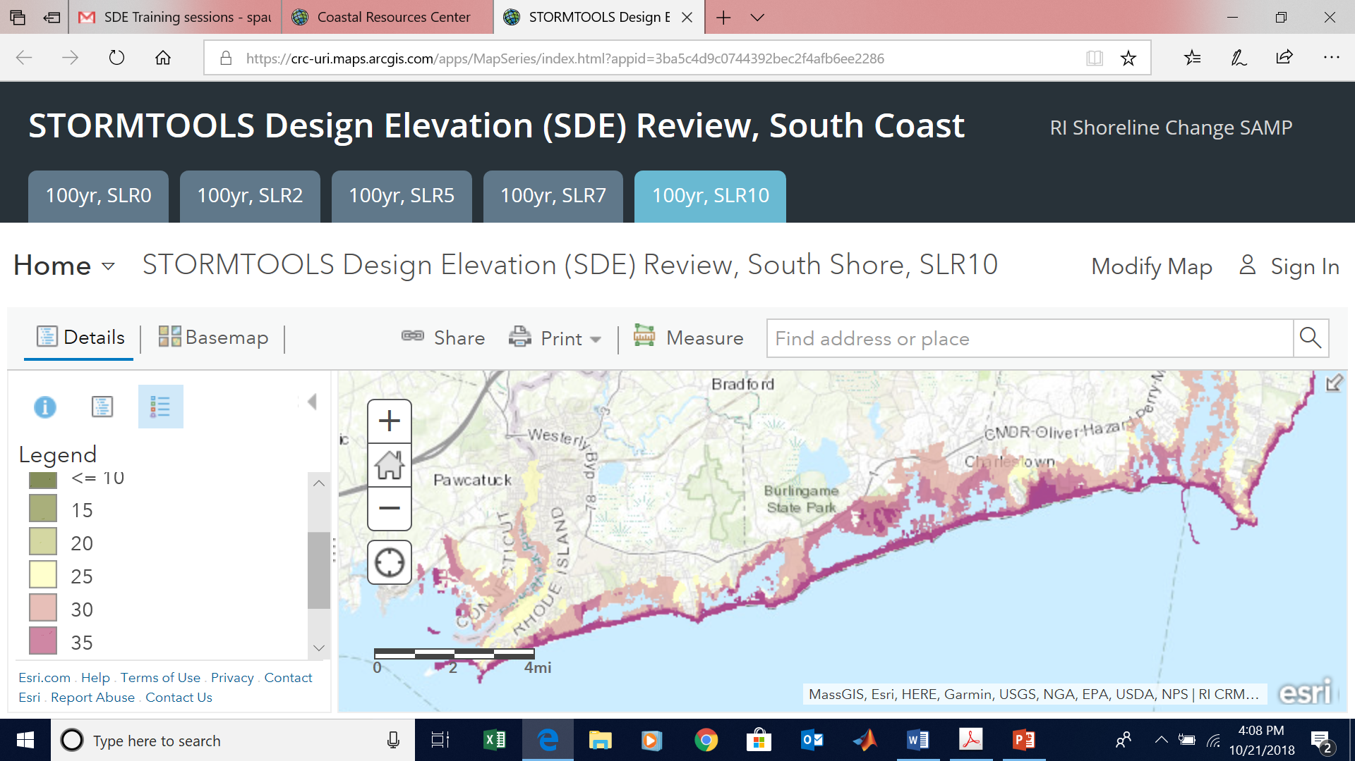
STORMTOOL’s Goal: To provide access to a suite of coastal planning and design tools for coastal and riverine flooding (numerical models, maps, data sets, etc.), available as a GIS based, web service, that allows wide spread accessibly and applicability at high resolution for user selected coastal and inland areas of interest.

Slide 3
STORMTOOLS Initiatives
Maps of flooding from sea level rise (0 to 12 ft); 25, 50, and 10o yr storms; nuisance flooding maps (1 ,2, 3, 5 and 10 yrs), flooding from historical storms (1938, Carol- 1954, Bob- 1991, and Sandy- 2012)
Development and application of Coastal Environmental Risk Index (CERI) to various communities in the state.
Development of Design Elevation Maps (SDEs) for Narragansett Bay and southern RI shoreline(South Coast).

Slide 4
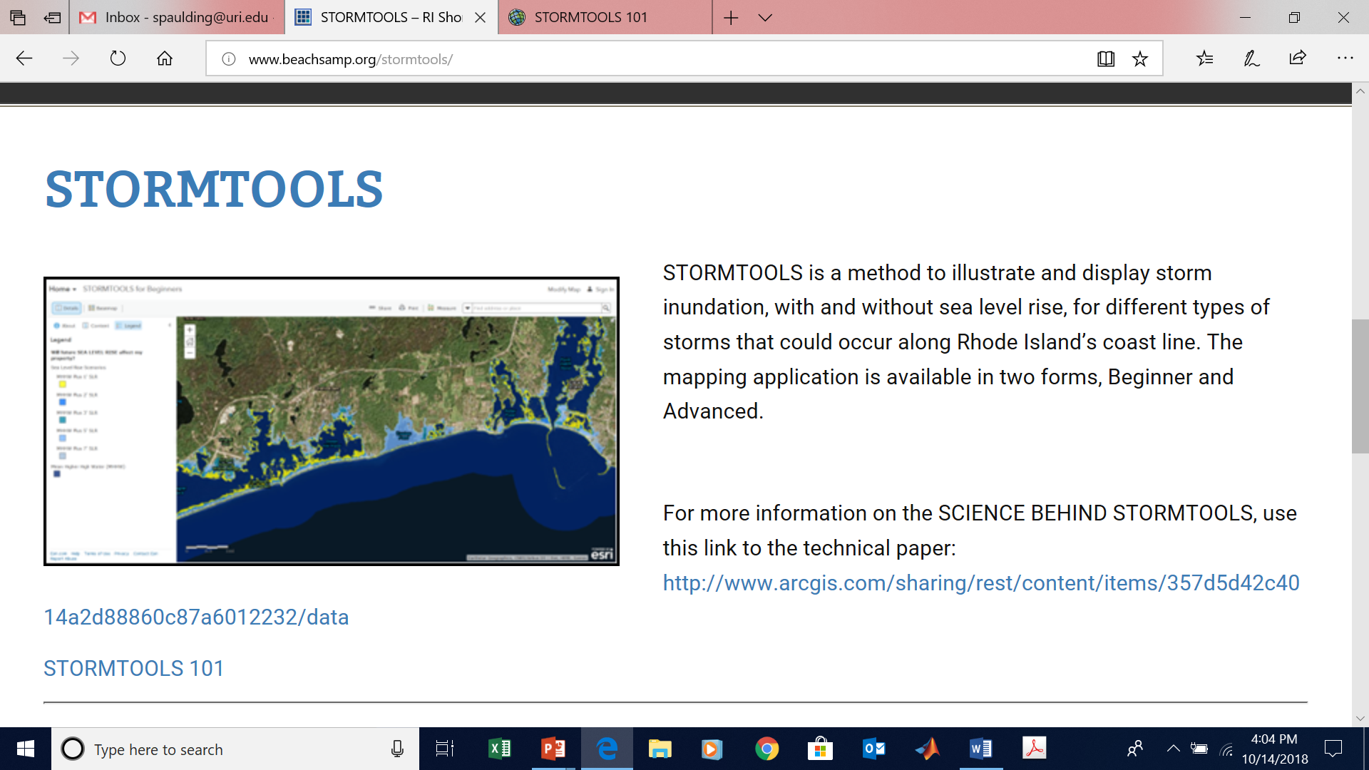

Slide 5
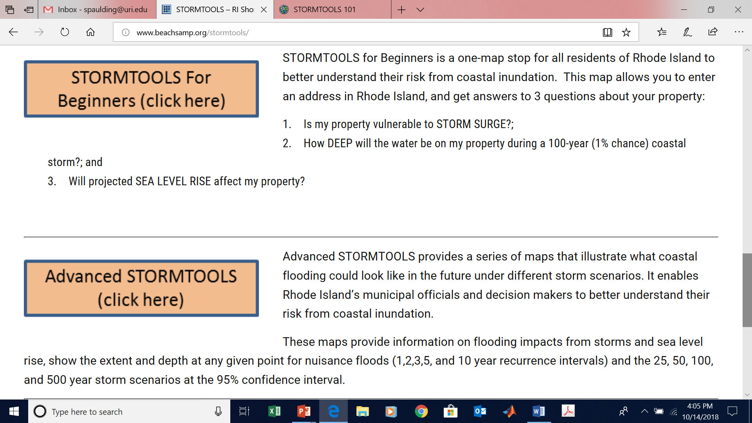

Slide 6
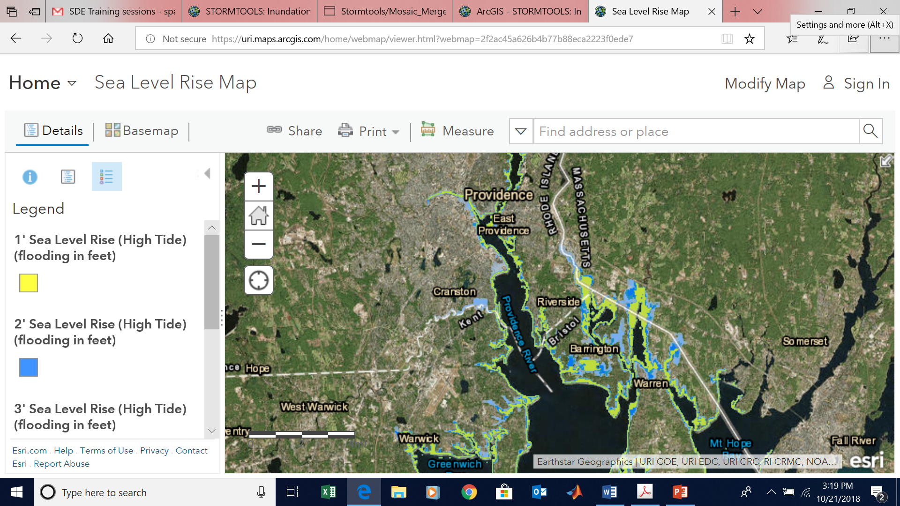

Slide 7
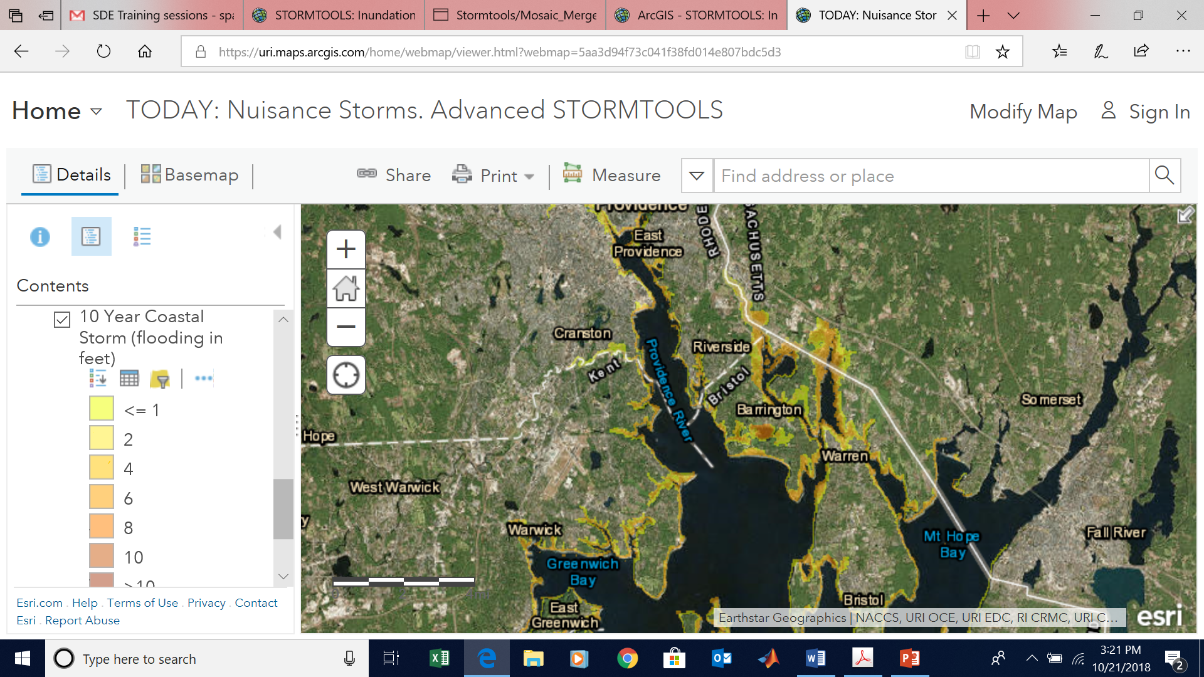

Slide 8
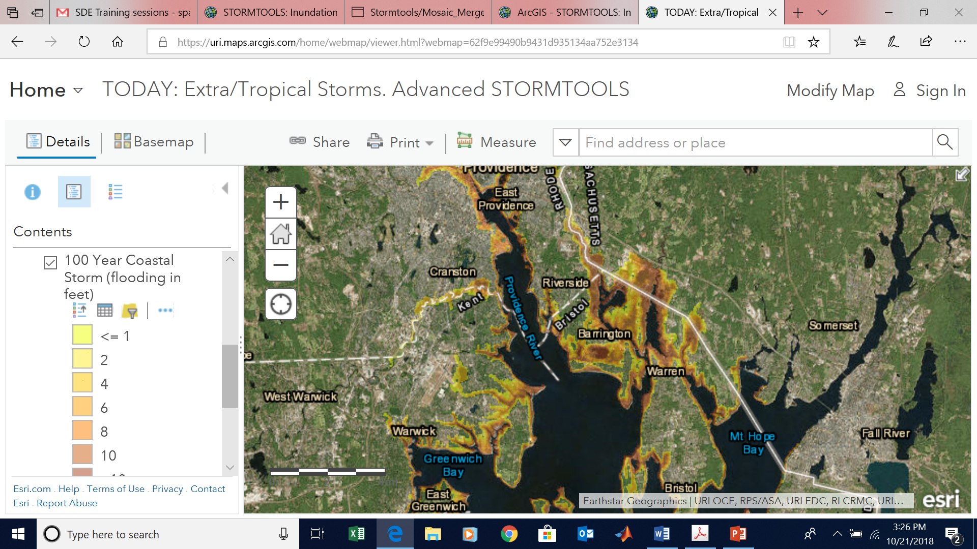

Slide 9
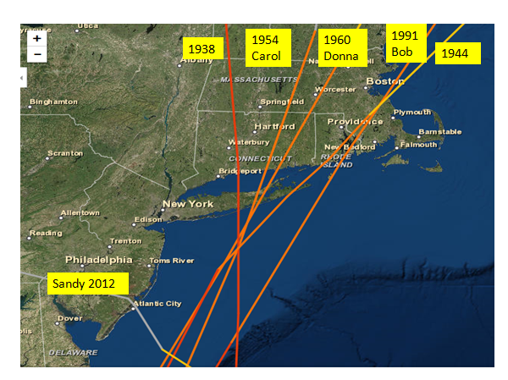
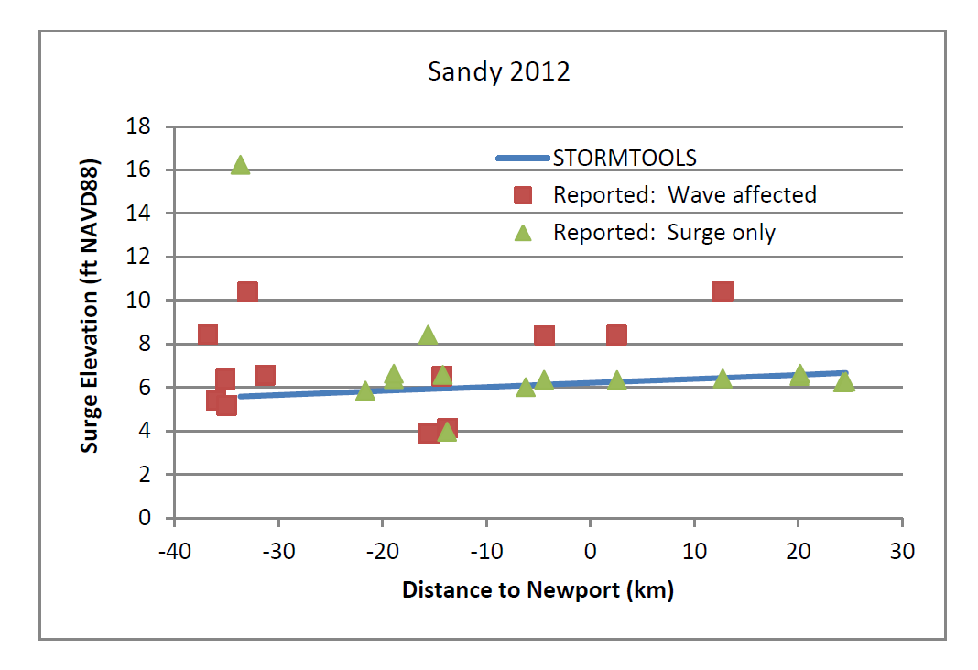
Validation with 1938, 1954, and 2012 hurricanes

Slide 10
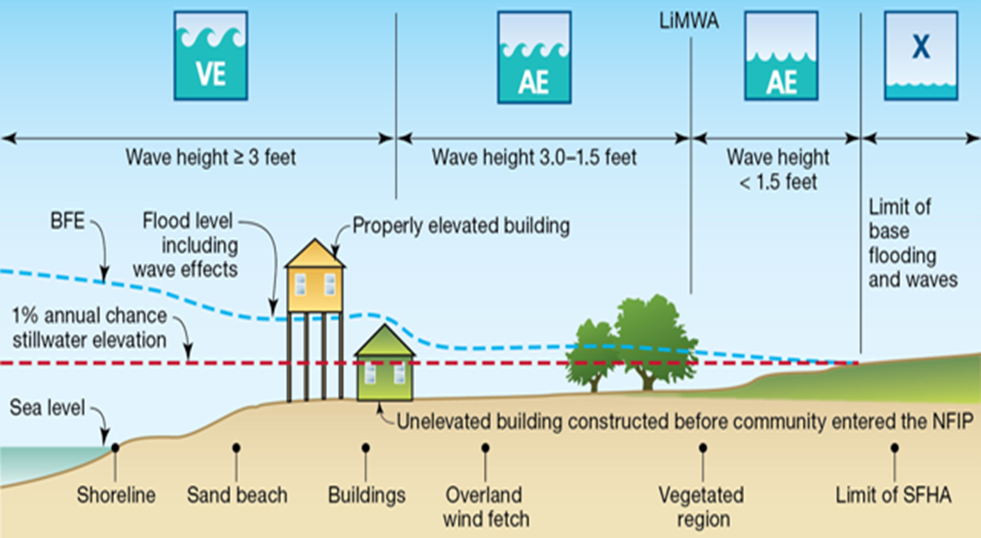
FEMA flood zones associated water levels and waves
BFE: referenced to NAVD88
Depth of inundation,
referenced to grade elevation
BFE
SWEL
SWEL
Inundation depth
NAVD88

Slide 11
FEMA - Flood Insurance Rate Maps (FIRMS)
Generated by FEMA for 100 and 500 yr return period surge for establishing flood insurance zones and rates. Maps expressed in terms of zones (VE, AE, and X) base flood elevation (BFE) (includes both surge and controlling wave heights).
FIRMS do not include sea level rise and hence their use to set building design standards does not accurately represent risk in the presence of sea level rise. (Their role is to determine flood zones and set flood insurance rates).
BFE maps often have serious problems (e.g. dated modeling technology, lack of consideration of uncertainty, lack of validation, subjective spatial interpolation, etc.)

Slide 12
CERI Goal:
To develop and apply a Coastal Environmental Risk Index *(CERI) to assess the risk that structures and infrastructure face from storm surges, including flooding and the associated wave environment, in the presence of sea level rise(SLR), and shoreline erosion/accretion.
* CERI uses percent damage (or cost of damage) associated with flooding and erosion as a proxy for risk.

Slide 13
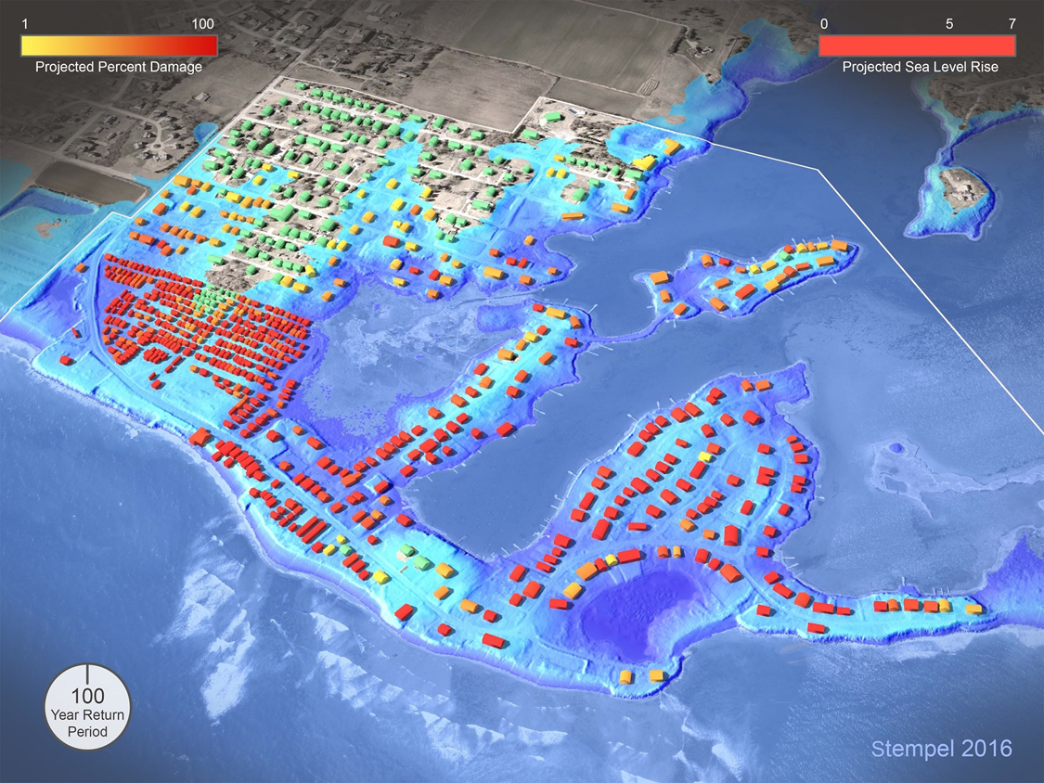
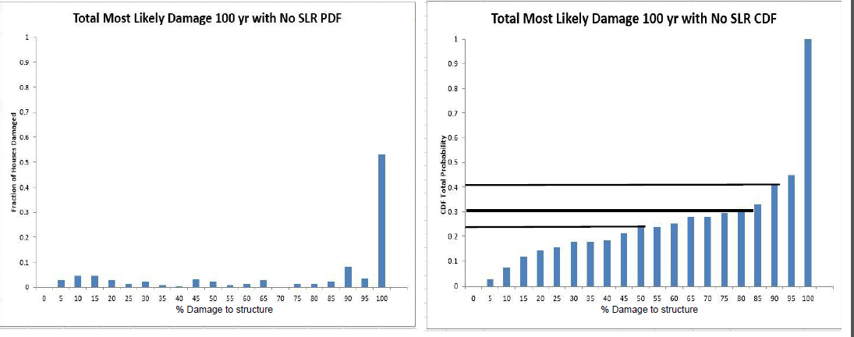
STORMTOOLs Coastal Environmental Risk Index (CERI) Flow Chart
BFEs
STORMTOOLs
Storm Water Level and Waves (100 yr, with SLR)
Structures and Infrastructure
Type and Elevation
ACOE/FEMA
Wave and Inundation Damage Functions by Structure Type
Winds and Wind Damage Functions
Flood/wind damage by individual structure/infrastructure
Probability distribution of damages
Damage by structure

Slide 14
CERI Building Blocks
Water levels (100 yr or specific storm event) for flooding, with or without SLR, available from STORMTOOLs. (http://www.beachsamp.org/resources/stormtools/)
Wave estimates (100 yr) for flood inundated areas, with and without SLR, based on state of the art wave models (STWAVE).
Shoreline change (erosion/accretion) estimates based on most recent 2016 RI CRMC shoreline change maps.
Damage functions by structure or infrastructure type based on data from superstorm Sandy (2012) (US Army Corp of Engineers(ACOE)/FEMA)).
Location/identification of individual structures and infrastructure from E911 and town and state data bases.

Slide 15
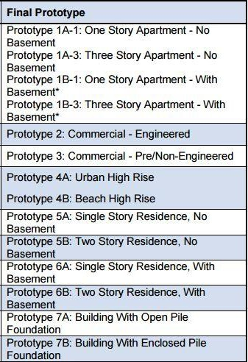
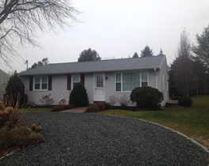
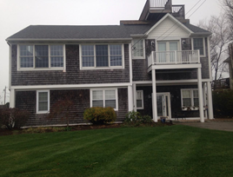
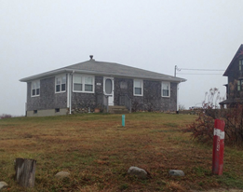
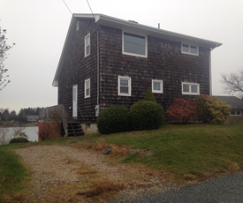
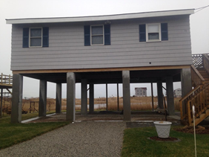
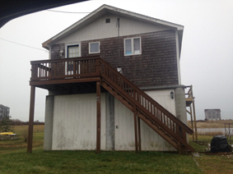
Army Corp Engineers-North Atlantic Comprehensive Coastal Study (NACCS) Structure Type
A
B
5
6
7

Slide 16
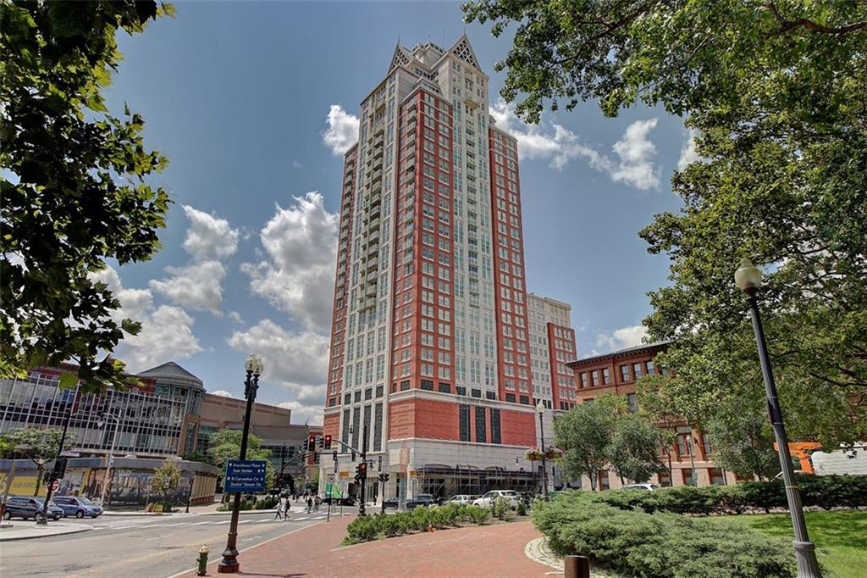
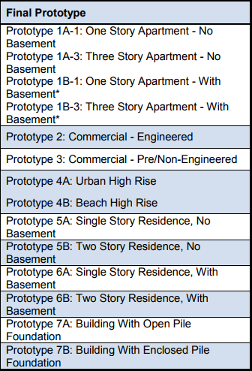
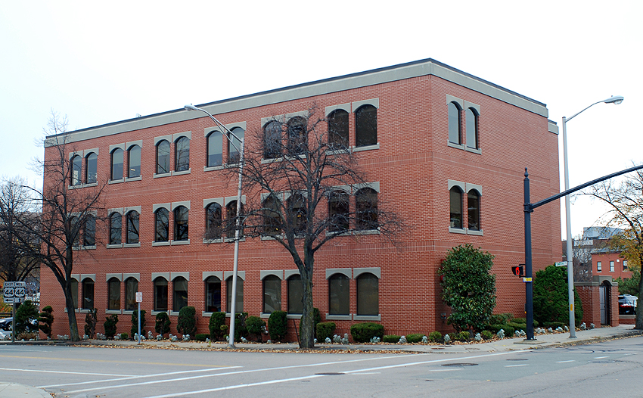
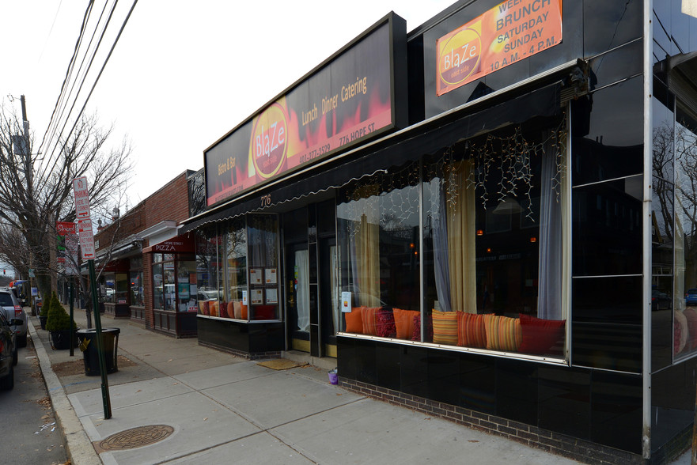
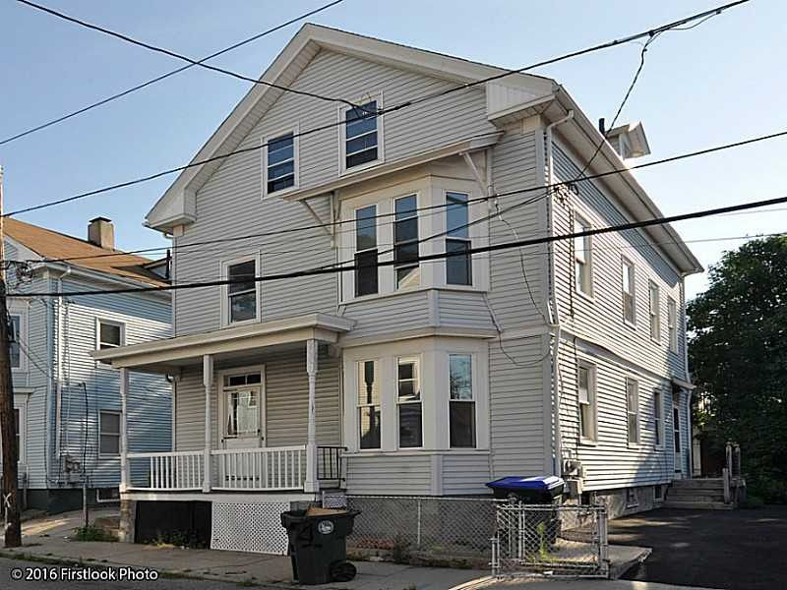
Structure Prototypes
2
3
4A
6B
Notes:
Matt
Explain why we do prototypes.
To estimate damage, structures must be prototyped

Slide 17

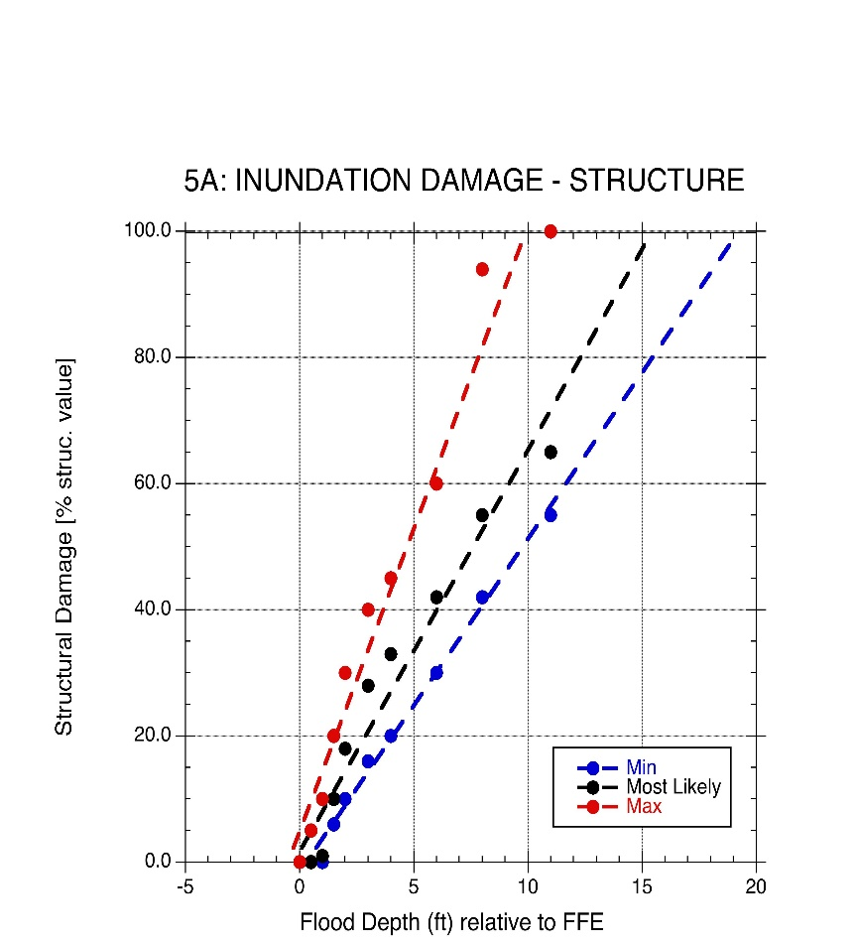
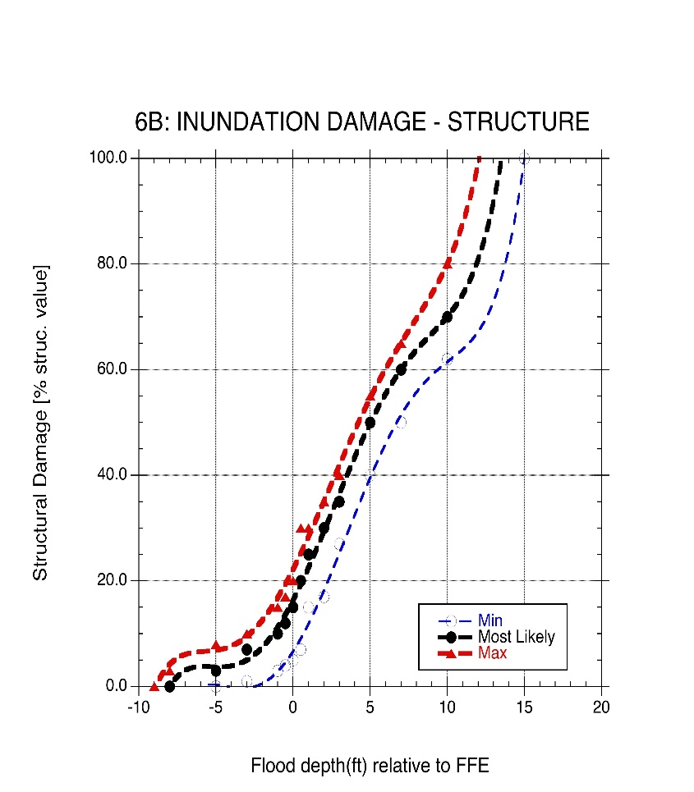
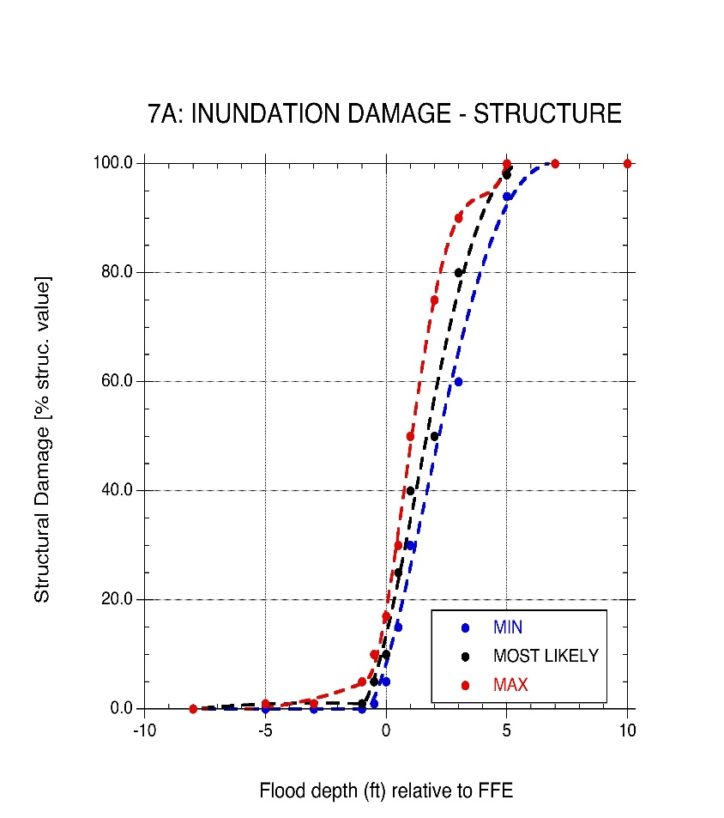
Structural Inundation damage by structure type

Slide 18
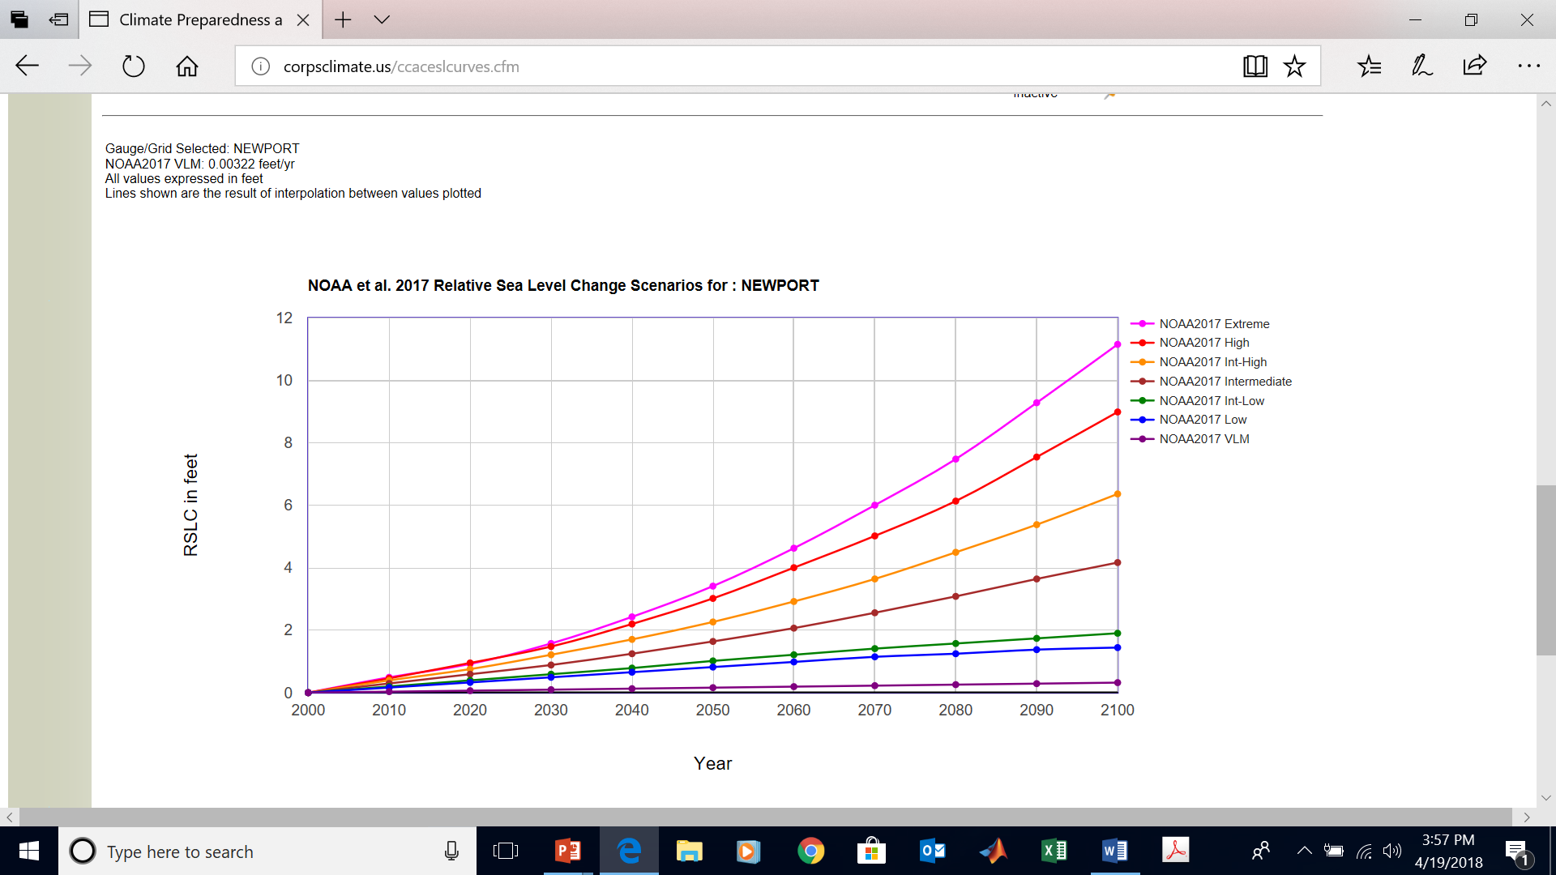

NOAA Sea Level Rise (SLR)
Newport, RI
CRMC SLR Guidance, NOAA High Curve (2018)
1.48 ft 2035
3.02 ft 2050
8.99 ft 2100
Scenarios for NEWPORT
NOAA2017 VLM: 0.00322 feet/yr
All values are expressed in feet
Year | NOAA2017 VLM | NOAA2017 Low | NOAA2017 Int-Low | NOAA2017 Intermediate | NOAA2017 Int-High | NOAA2017 High | NOAA2017 Extreme
2000 | 0.00 | 0.00 | 0.00 | 0.00 | 0.00 | 0.00 | 0.00
2010 | 0.03 | 0.16 | 0.20 | 0.30 | 0.39 | 0.46 | 0.49
2020 | 0.06 | 0.33 | 0.39 | 0.59 | 0.75 | 0.95 | 0.92
2030 | 0.10 | 0.49 | 0.59 | 0.89 | 1.21 | 1.48 | 1.57
2040 | 0.13 | 0.66 | 0.79 | 1.25 | 1.71 | 2.20 | 2.43
2050 | 0.16 | 0.82 | 1.02 | 1.64 | 2.26 | 3.02 | 3.41
2060 | 0.19 | 0.98 | 1.21 | 2.07 | 2.92 | 4.00 | 4.63
2070 | 0.23 | 1.15 | 1.41 | 2.56 | 3.64 | 5.02 | 6.00
2080 | 0.26 | 1.25 | 1.57 | 3.08 | 4.49 | 6.14 | 7.48
2090 | 0.29 | 1.38 | 1.74 | 3.64 | 5.38 | 7.55 | 9.28
2100 | 0.32 | 1.44 | 1.90 | 4.17 | 6.36 | 8.99 | 11.15
RSLC- Relative Sea Level Change

Slide 19
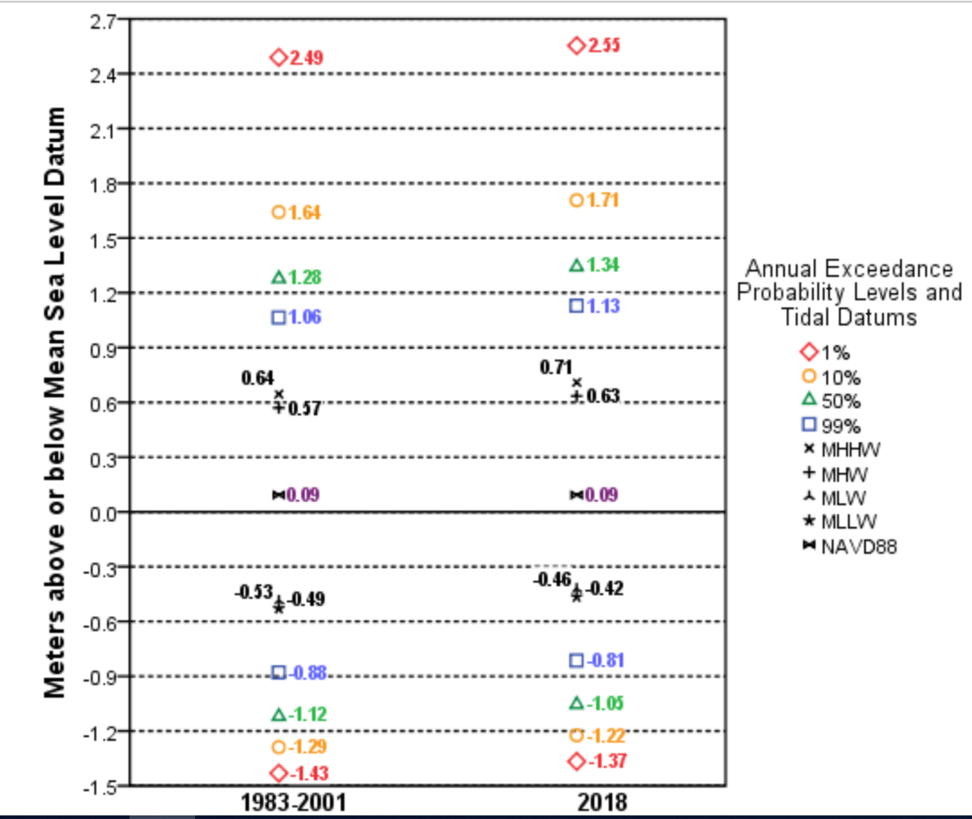
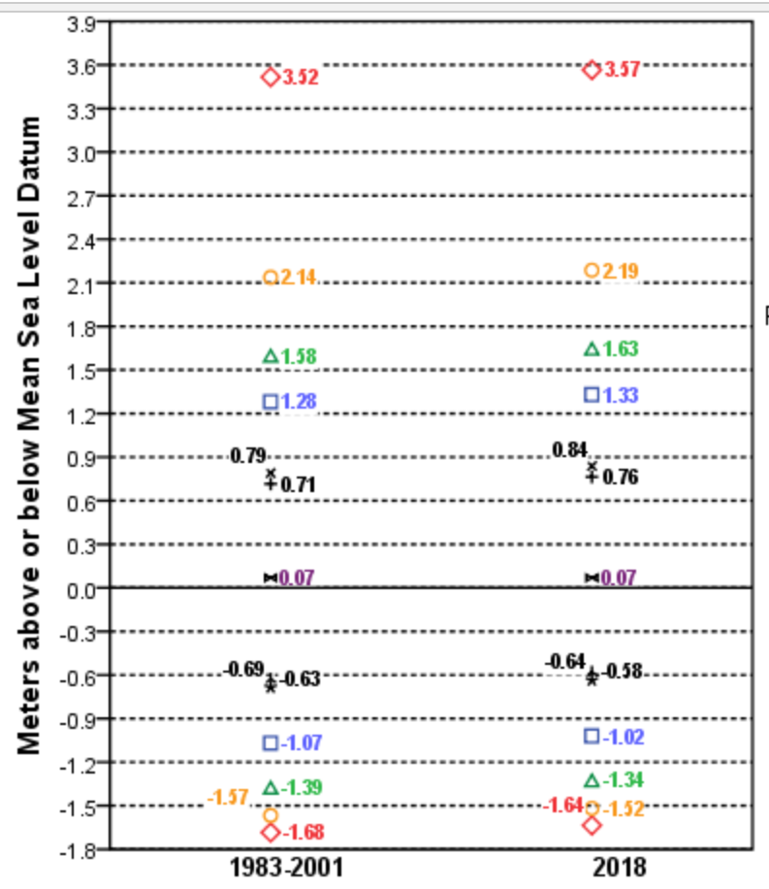
Water levels Newport and Providence, RI, NOAA NOS COOPS
Newport
Providence

Slide 20
CERI Applications *
Eastern Matunuck Beach (OCE Senior Design Class 2015-2016, Small et al, 2016)
Charlestown and Warwick, RI (HUD supported, Spaulding et al, 2016)
Misquamicut Beach, RI (OCE Senior Design Class 2016-2017)
Providence and Fox Point Hurricane Barrier (OCE Senior Design Class 2017-2018)
Barrington, Warren, and Bristol, RI (HUD supported, in progress)
STORMTOOLS Design Elevation Maps (SDE) for RI (draft maps complete). (https://crc-uri.maps.arcgis.com/home/index.html)
Waste Water Treatment Facilities (WWTF) (Fields and Bucklin Pts) and above ground storage tanks (AST) in upper Narragansett Bay (in progress, September 2018)
* http://www.beachsamp.org/stormtools/stormtools-coastal-environmental-risk-index-ceri/

Slide 21
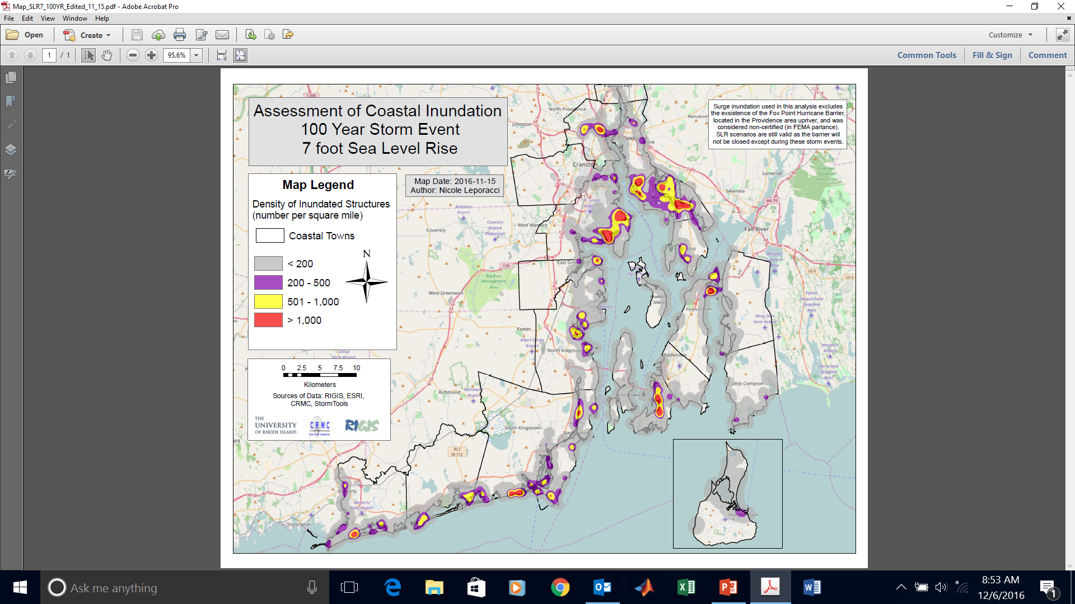
HUD Funded, Warwick and Charlestown, RI,
Completed, May 2017
HUD Funded, Barrington, Bristol, and Warren, RI, May 2019
OCE Seniors Design Class
Matunuck, RI, completed May 2016
Misquamicut, RI, completed May 2017
Fox Pt Hurricane Barrier, Providence, RI
completed May 2018
NOAA PSM
Southern RI shoreline, in progress

Slide 22
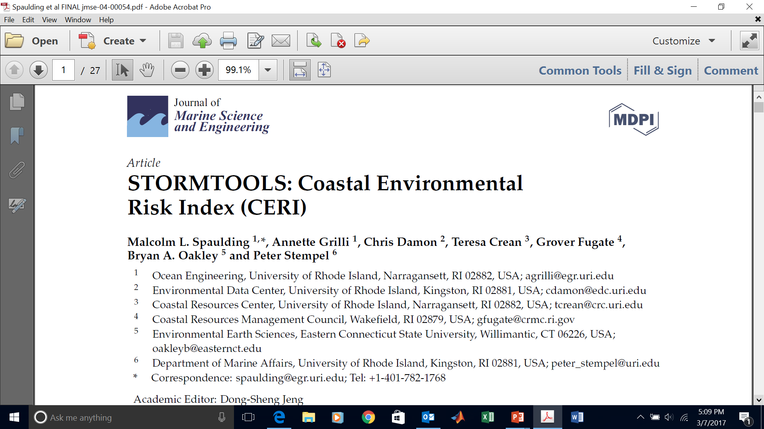
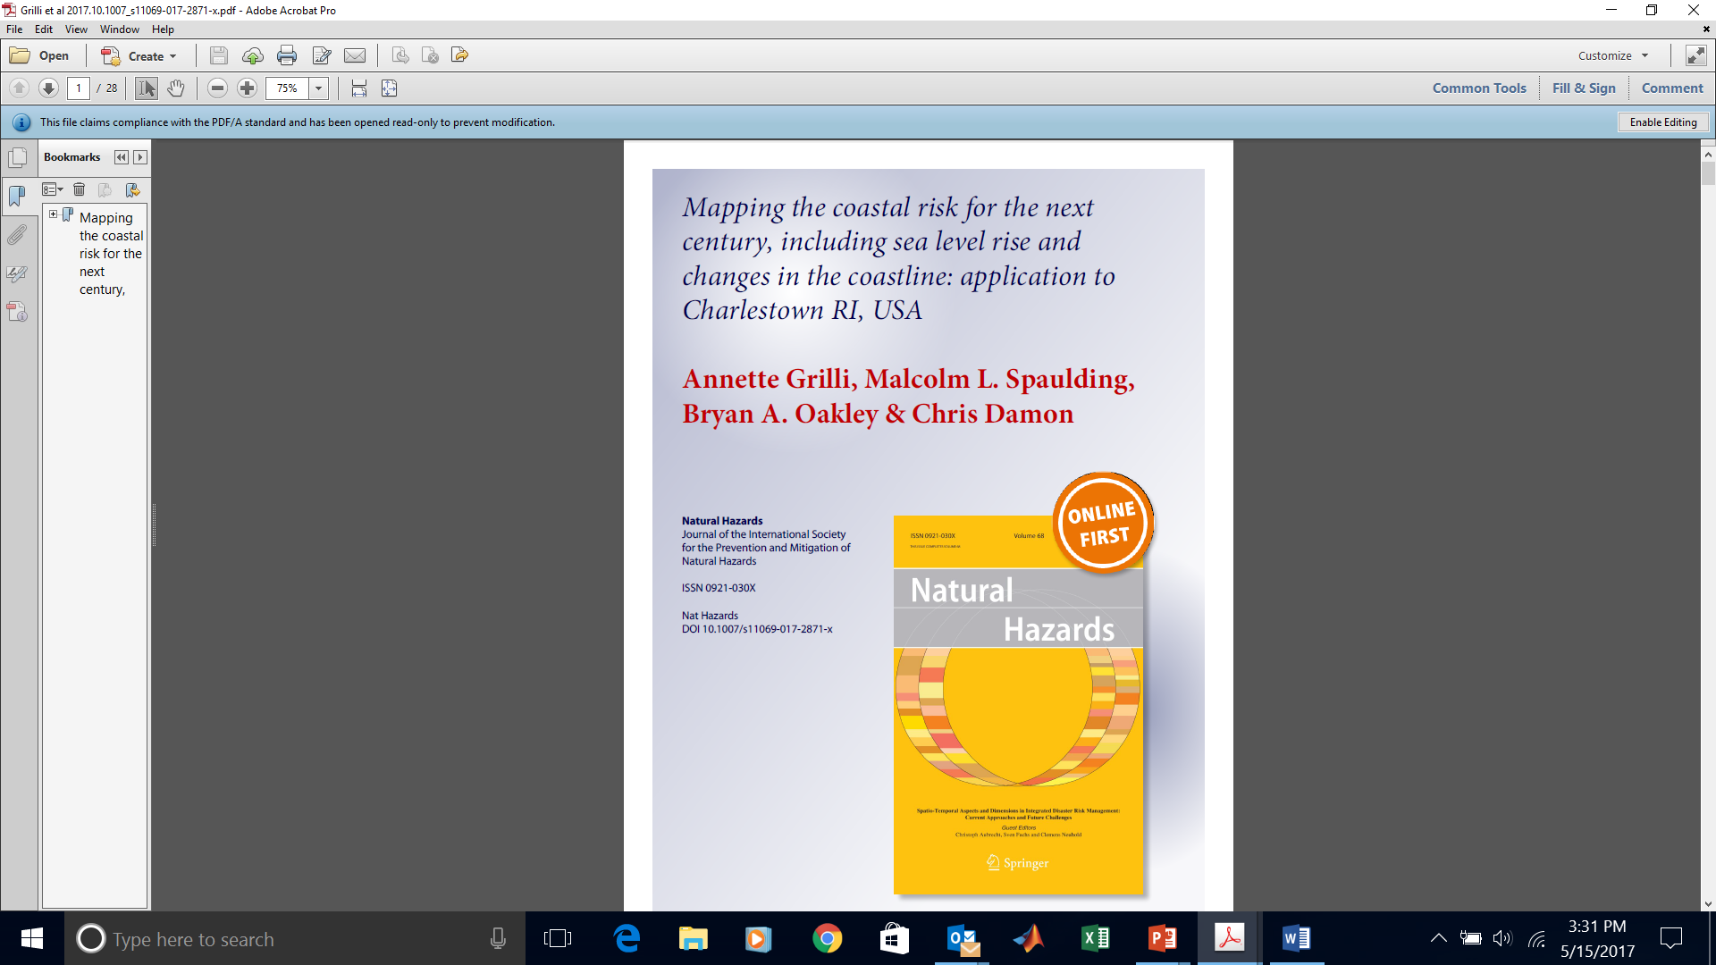
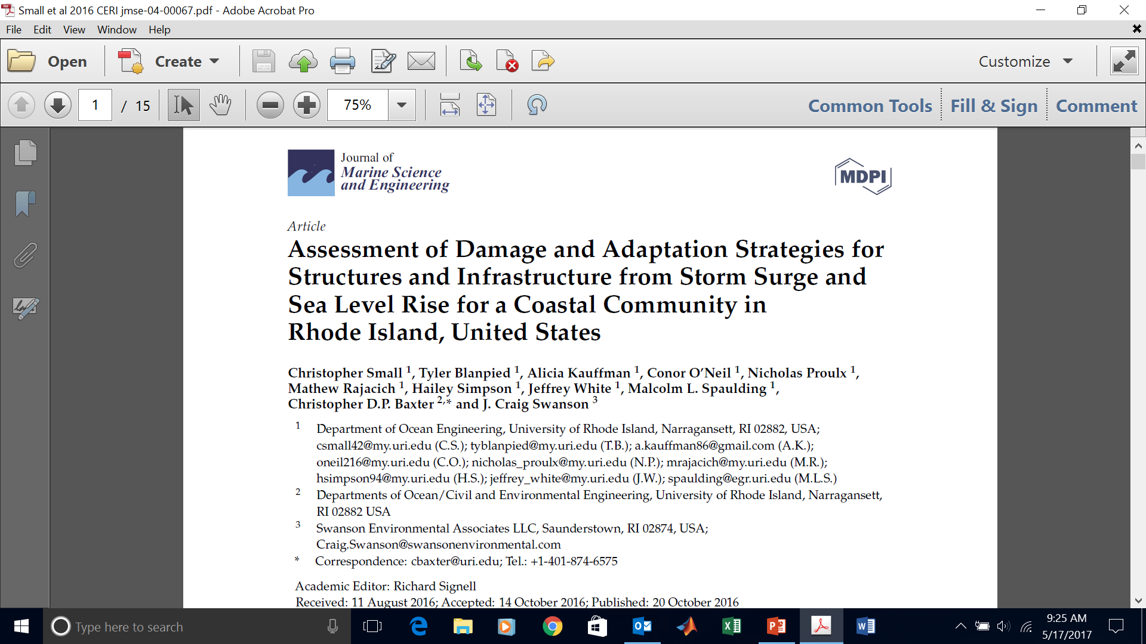
Papers on STORMTOOLS and applications
http://www.beachsamp.org/stormtools/stormtools-coastal-environmental-risk-index-ceri/

Slide 23
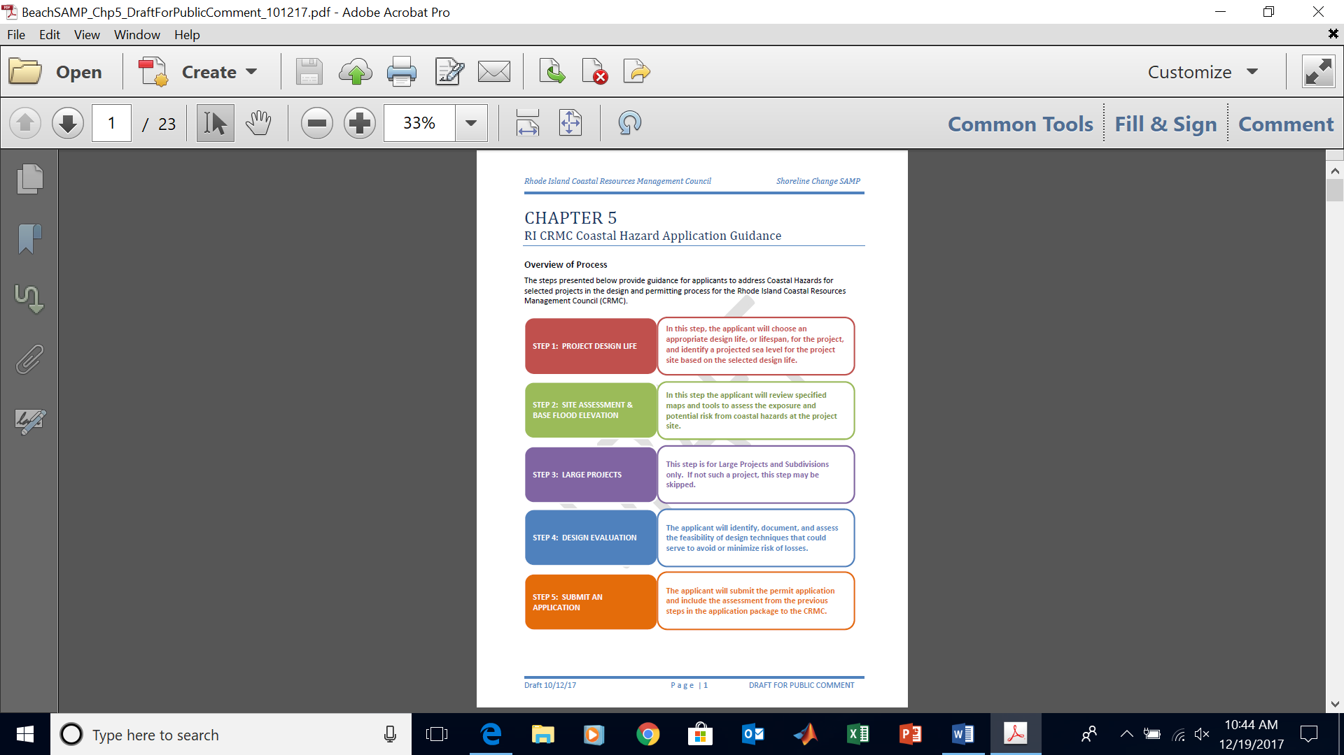
RI Beach SAMP
Risk Based Permitting System (June 2018)
* Select design life for structure/infrastructure
* Determine wind and flood risk over design life (including effects of climate change, i.e. sea level rise) (STORMTOOLs Design Elevation Maps)
* Assumptions of risk based on design life selected by applicant and registered on property deed.

Slide 24
STORMTOOLs Design Elevation Maps(SDE)
BFE maps of coastal study area that explicitly include the effects of sea level rise, (used as input to CERI).
SDE maps can also be used in place of FEMA FIRMs for the design of structures and infrastructure design. ( embedded in CRMC risk based permitting system).
SDE map for the specified sea level rise value selected based on proposed design life of the structure (present date + design life = design date; sea level rise value from NOAA High Curve).
SDE maps will serve as an alternative to FEMA FIRMs, and may ultimately replace FIRMs in RI.
Freeboard offsets can be added to SDE elevations, as appropriate.

Slide 25
SDE Maps based on upper 95% confidence limit of flooding. Why?
Large uncertainty in water levels of flooding at 100 yr return period: two major hurricanes: 1938 and 1954 dominate upper end of historical record.
Use of mean value ( 50 % confidence limit) of 100 yr inundation underestimates the risk that structures might experience in the future. See examples from recent hurricanes: Florence and Michael.
Used to address uncertainty in the analysis methodology.
Difference is consistent with impact of climate change on storm inundation. Current 95% confidence limit is consistent with 50% confidence limit considering impact of climate change on storm flooding in the future.

Slide 26
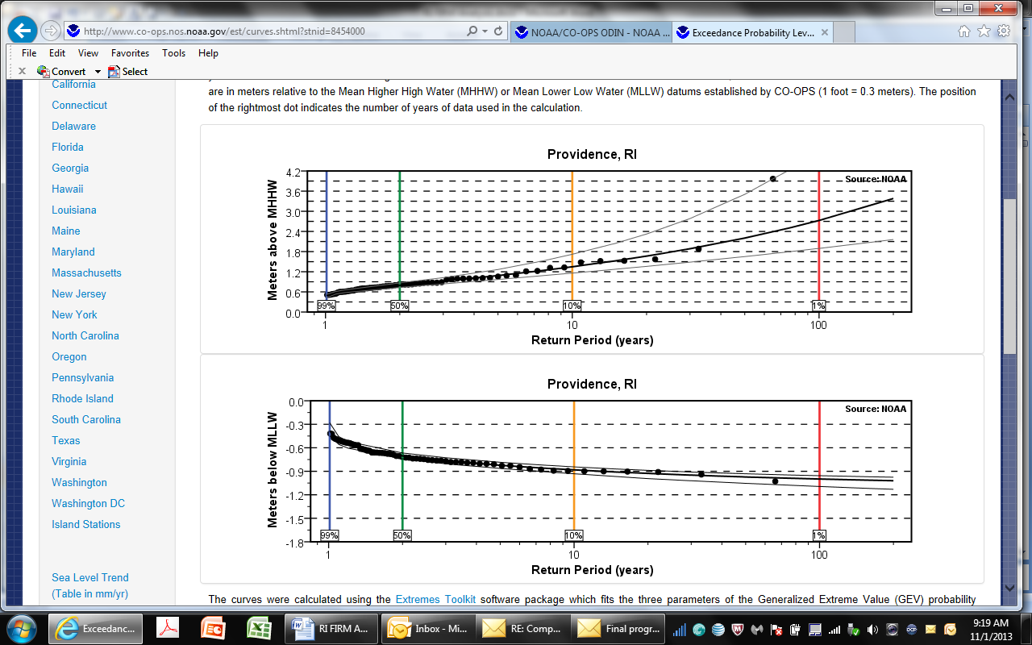
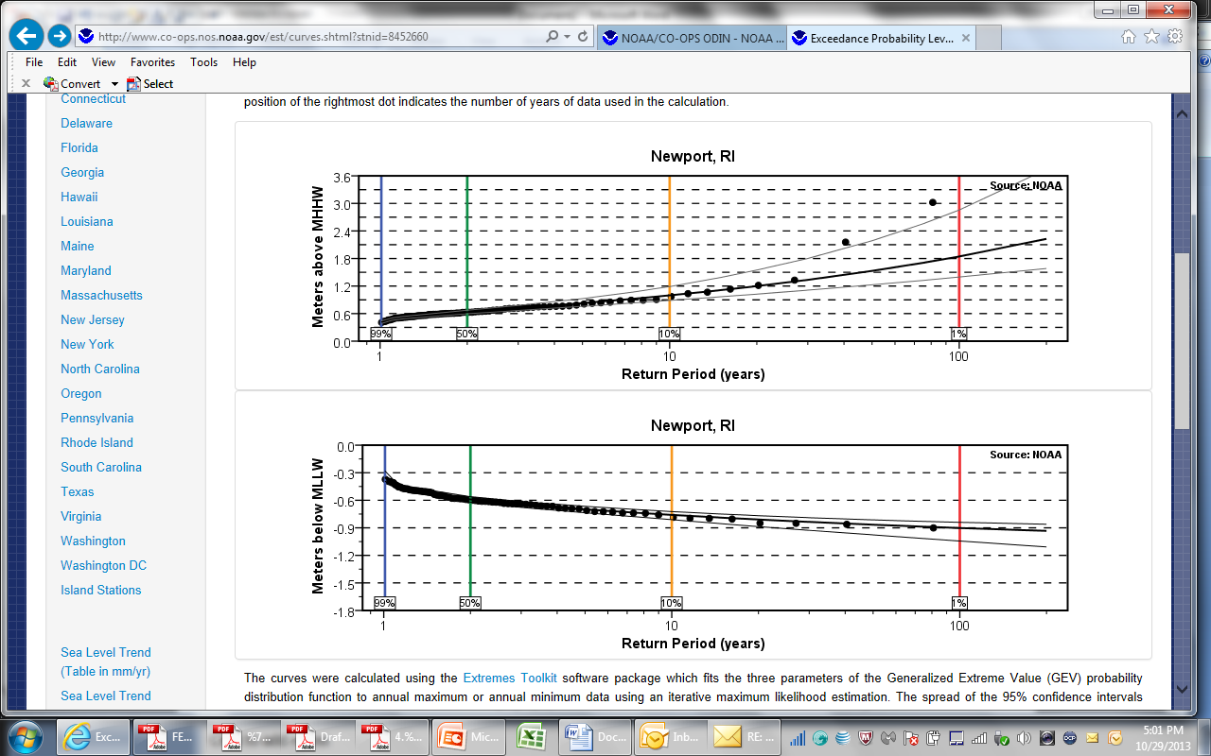

Extremal Analysis
based on storm water level data at NOAA NOS stations
Large Uncertainty
Storms in rank order
(relative to MHHW)
Newport, RI
1938 – 2.88 m (9.44 ft)
1954 -2.06 m (6.75 ft)
2012 -1.284 m (4.21)
1991-1.212 m (3.97 ft)
1944-1.206 m (3.95 ft)
1978 -1.1 m (3.6 ft)
1938
1954
2012
1954 missing at Providence

Slide 27
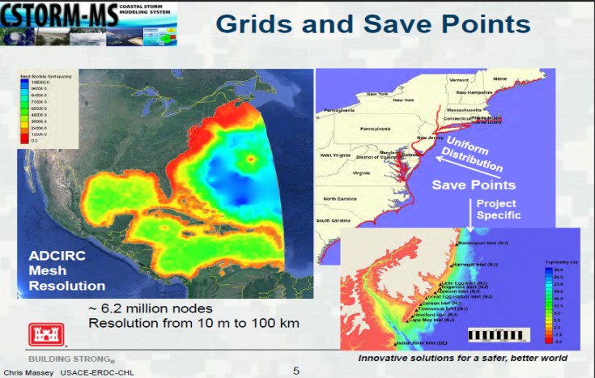
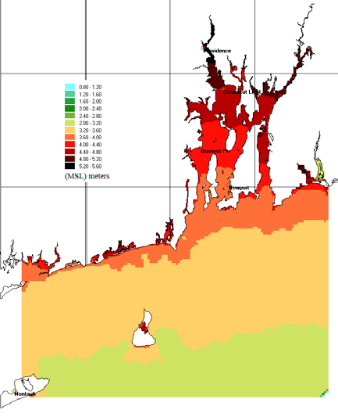
SDE Numerical Modeling Framework
Simulations of synthetic tropical (1000) and historical extratropical storms (100) using coupled ADCIRC and SWAN in ACOE North Atlantic Comprehensive Coastal Study (NACCS). Data stored at save points. Highest grid resolution (10 to 30 m).
Model system operational for RI at greatly enhanced resolution (3-5 m), Validated.
Simulation of waves in the presence of 100 yr surge and sea level rise and shoreline erosion using STWAVE.
Simulation of shoreline erosion/accretion in presence of sea level rise (XBEACH).
100 yr surge and waves, with tides, 95% confidence interval

Slide 28
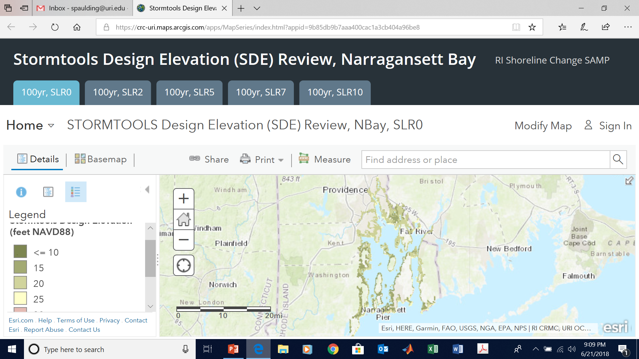
https://arcg.is/1jjbS8

Slide 29
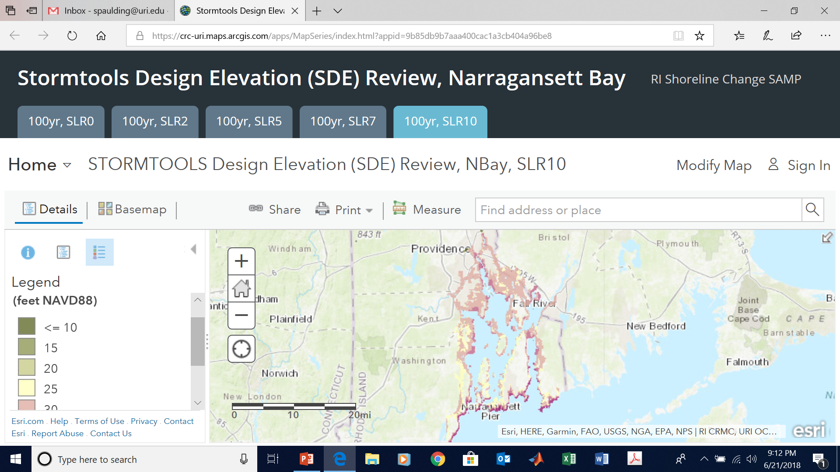

Slide 30
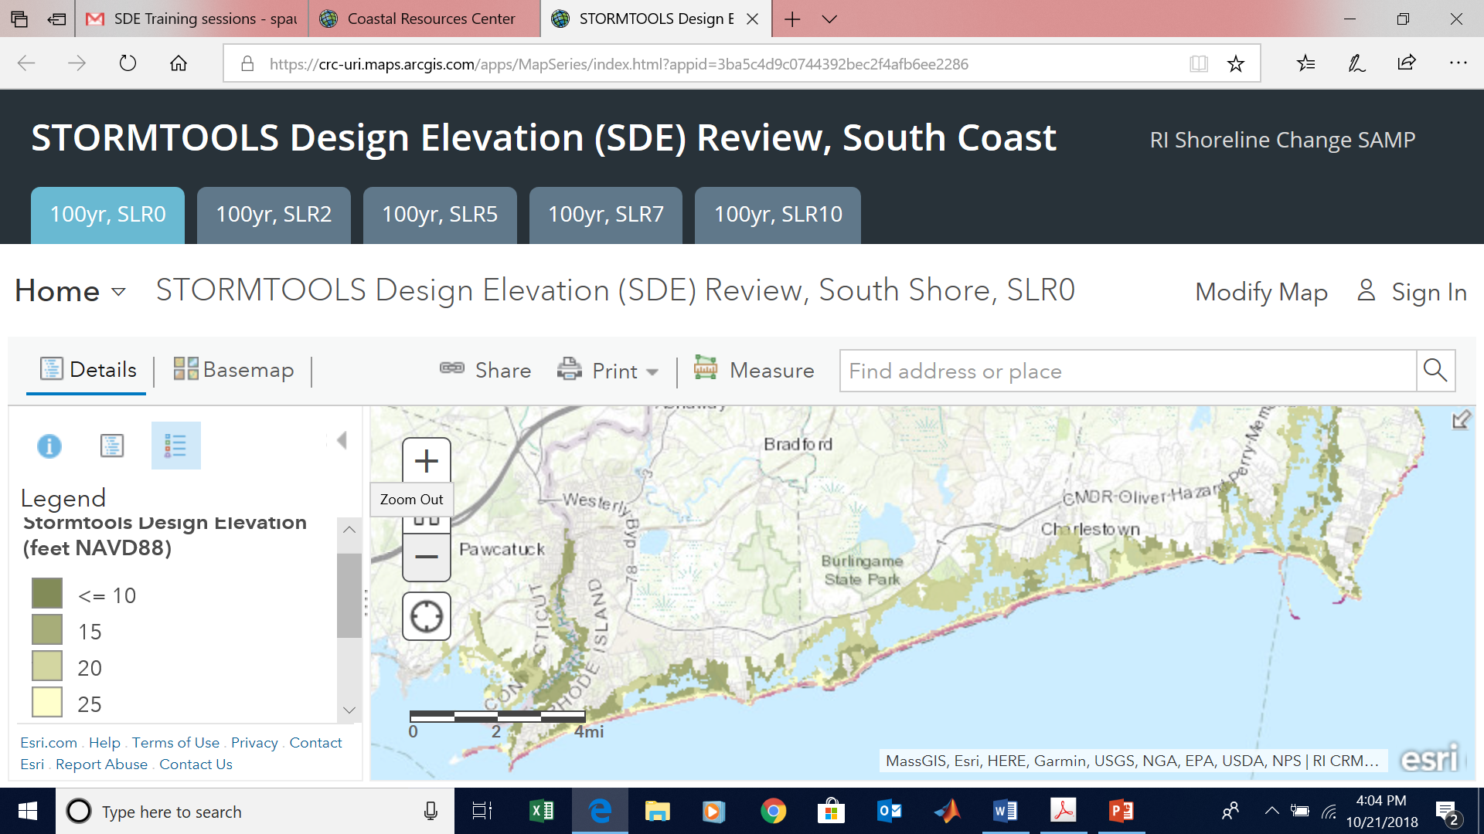

Slide 31
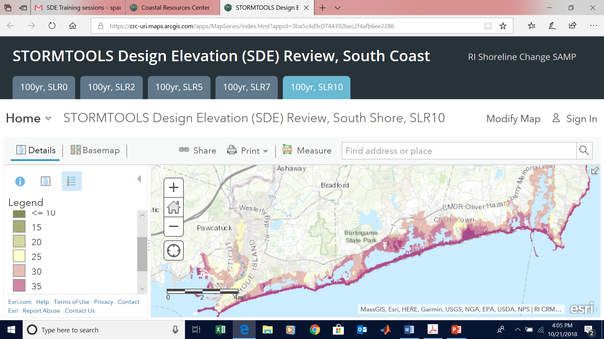

Slide 32
Summary: STORMTOOL’s SDE Maps
Objective, quantified analysis to assess flood risk using state of the art models and methods. Readily extendable to estimate damage.
Explicitly considers effects of sea level rise for various time horizons.
Assesses risk for both structures and infrastructure.
Web (publically) accessible, GIS based, downloadable, transferrable, and simple to use.
Method is consistent with building codes currently used in most states (ASCE 7-16)
Consistent with CRMC’s newly adopted risk based permitting policy.

Slide 33
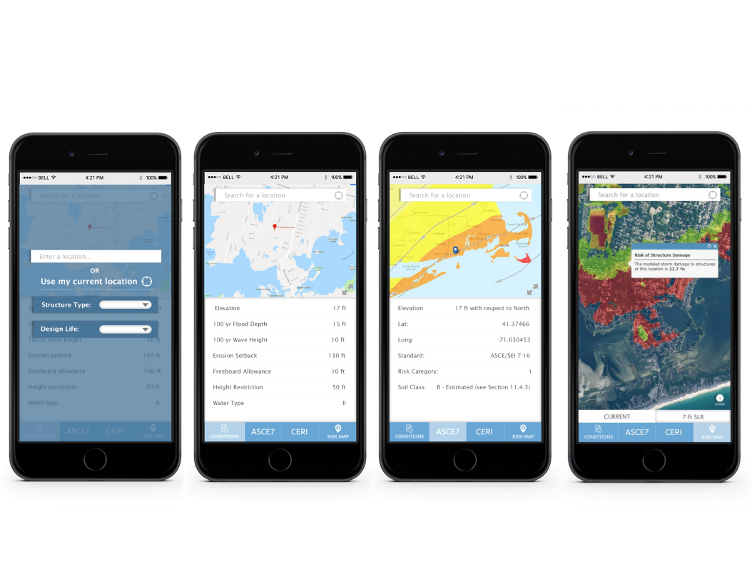
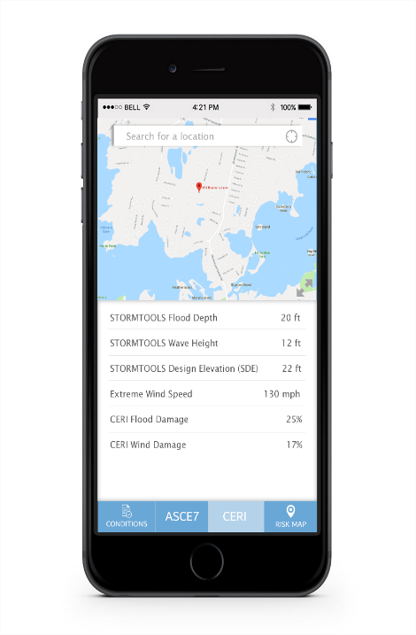
The future: CERI Risk and Damage & SDE App(start Oct 2018)
Structure Type, Design Life and Location
Flood and Wind Damage
Site Flood Characterization
Extremal Wind Speeds
Flood Risk Maps

Slide 34
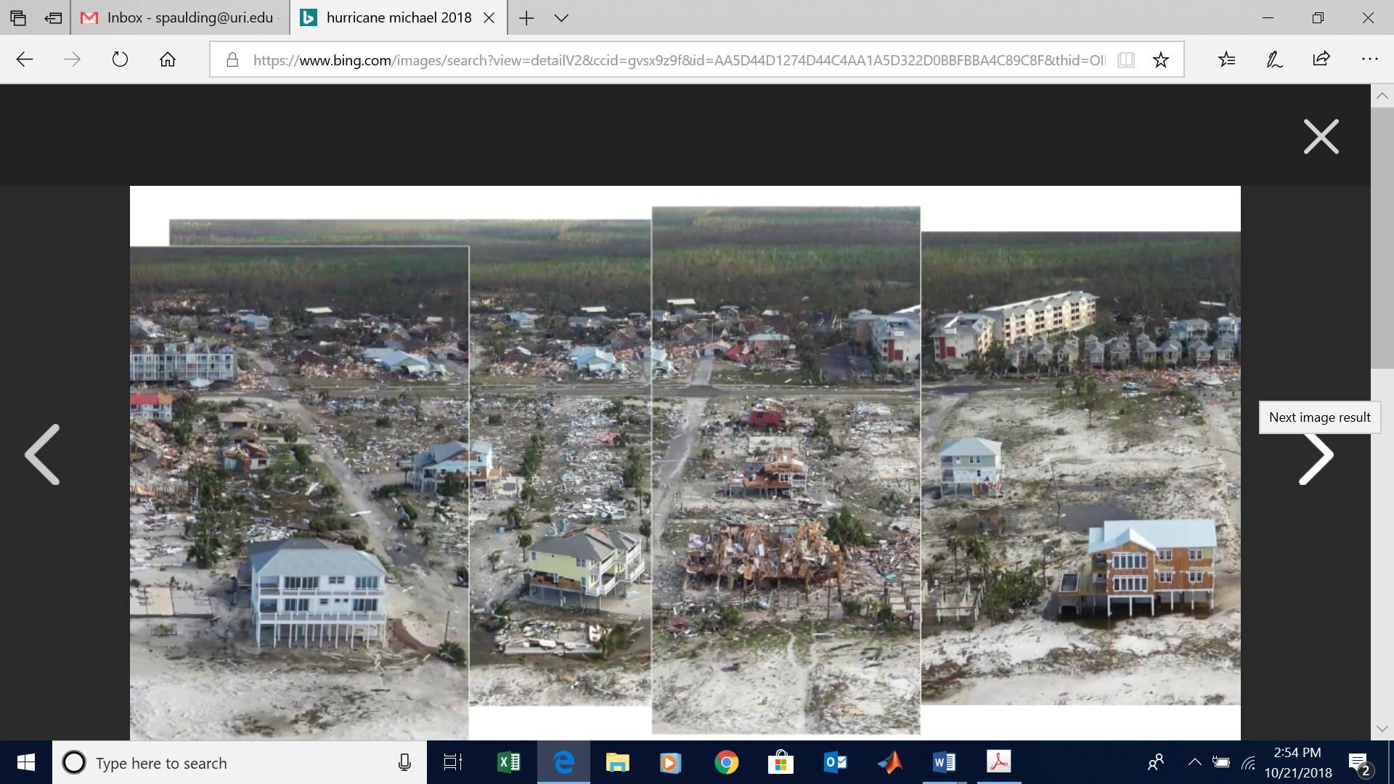
QUESTIONSS
Mexico Beach, FL; Hurricane Michael, 2018
NY Times Composite

Slide 35
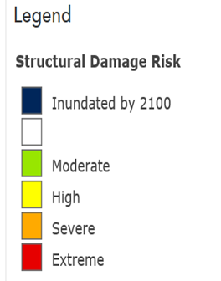
Risk maps based on SDE with SLR
Municipalities requested simplified maps that provide community leaders and the public a simple way to assess the risk of constructing a structure at any location in the town/county.
Maps must consider SLR and resulting change in sea level, erosion, and BFEs.
Method was to apply CERI and assume dominate structure
  type was at every location. Map scaled based on likely damage
  at the location: low to extreme and below MSL or eroded.

Slide 36
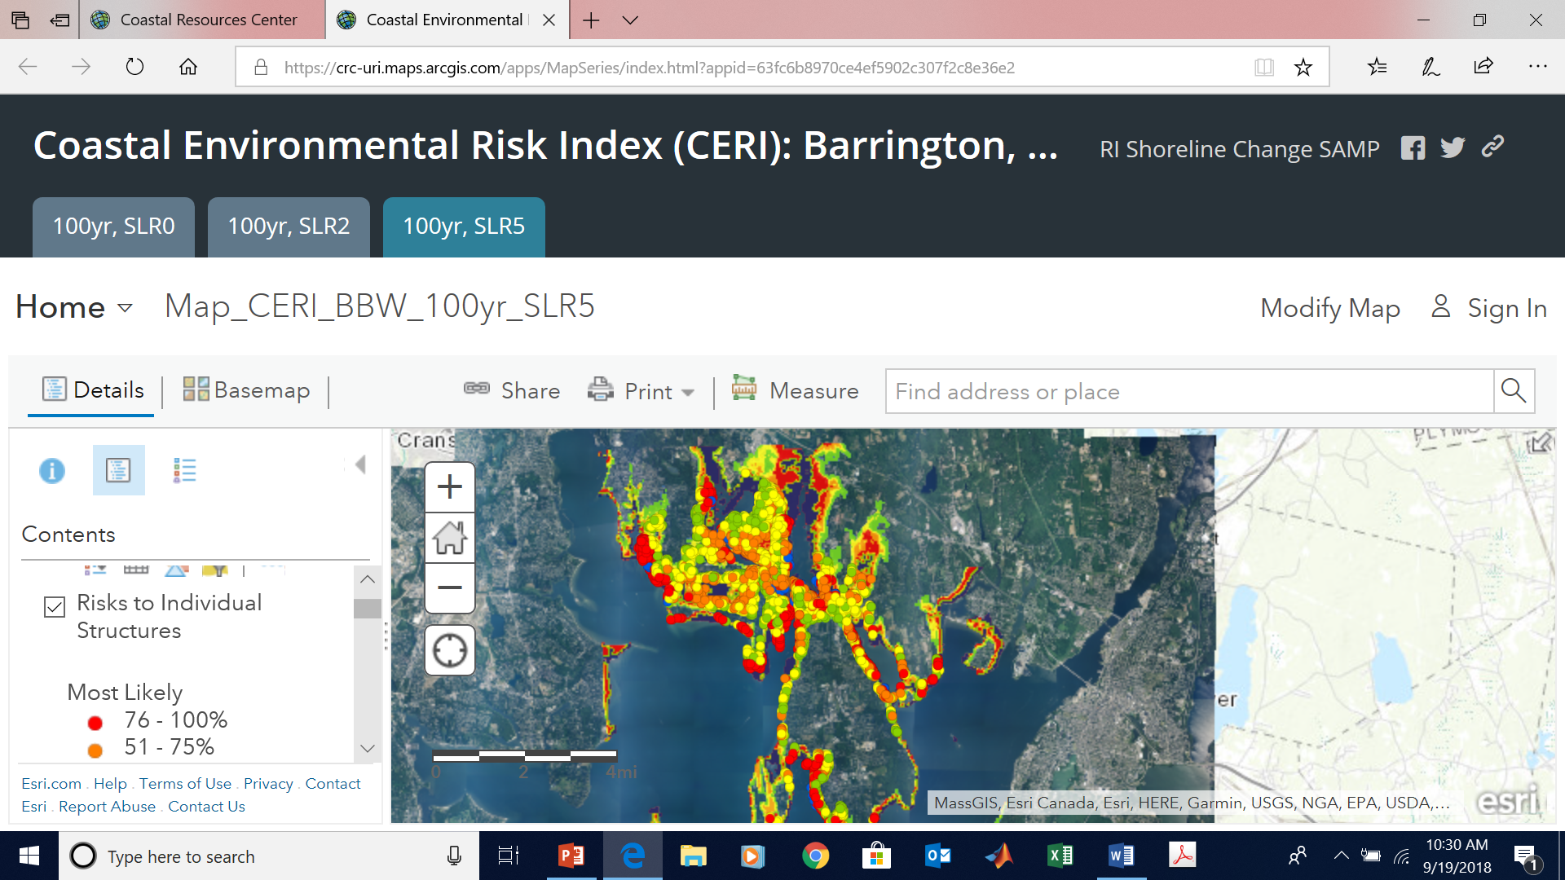

Slide 37
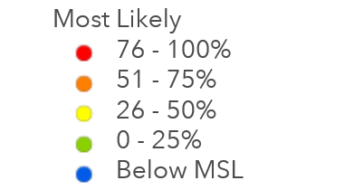
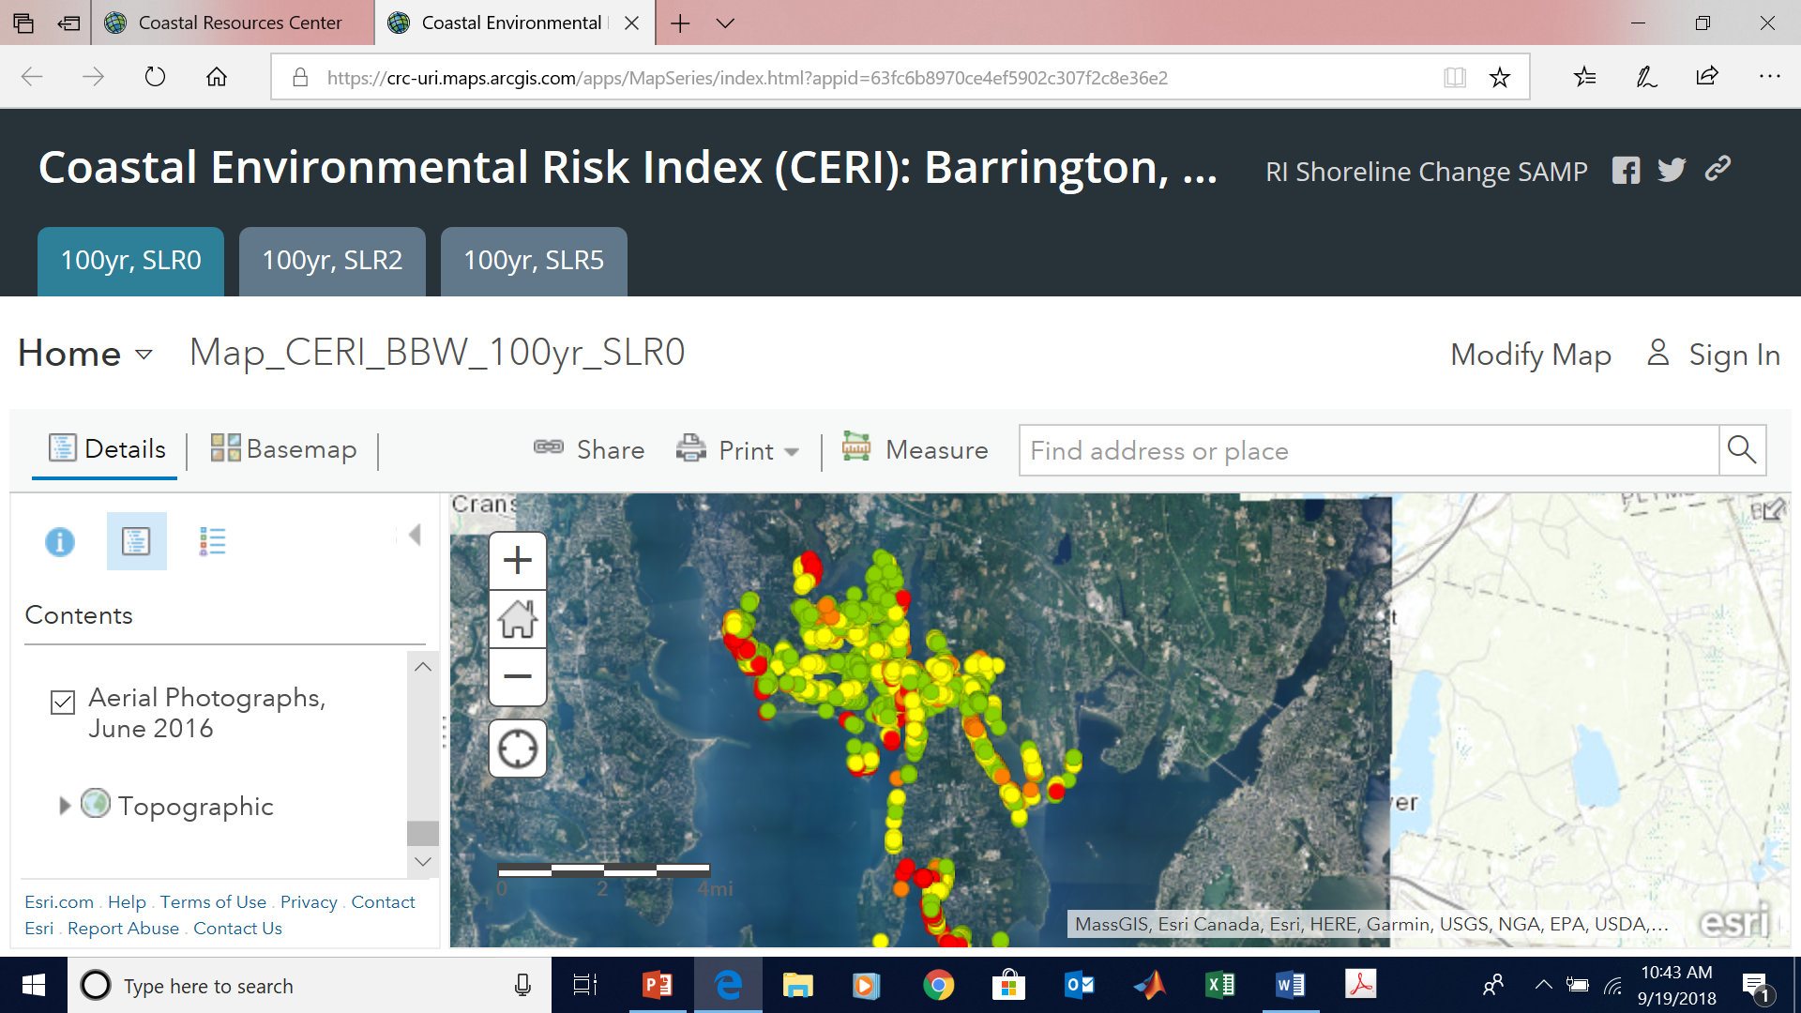


Structures at risk/damaged
no SLR
2 ft SLR
5 ft SLR

Slide 38



Overlay Structure Damage and Risk Maps
(5 ft SLR)
Structure damage %
Risk Maps
Damage and risk maps overlaid

Slide 39
STORMTOOLS Design Elevation Maps- Generation Method
Narragansett Bay: Low waves, little erosion
Sea Level Rise(SLR)
estimate
for design life
Surge 100 yr return period analysis from NACCS data base
>
+
Wave heights (STWAVE)
*Offshore boundary condition from NACCS wave analysis
*Local wind forcing for bay, along central access
=
BFE for SLR scenario
Southern RI shoreline: Large waves, significant dune erosion
Wave heights (STWAVE)
*Offshore boundary condition from NACCS wave analysis
*Revised digital elevation model (Xbeach)
* Local wind forcing for bay, along central access
Surge 100 yr return period analysis from NACCS data base
Erosion/Geo-morphology Xbeach
Offshore boundary condition from NACCS
Sea Level Rise(SLR)
estimate
for design life
=
+
+
>
BFE for SLR scenario

