Slide 1
TRAINING ACCESS TO SDE MAPS
General access to CERI and SDE maps:
https://crc-uri.maps.arcgis.com/home/index.html
Access to SDE Narragansett Bay
https://crc-uri.maps.arcgis.com/apps/MapSeries/index.html?appid=9b85db9b7aaa400cac1a3cb404a96be8
Access to SDE South Coast
https://crc-uri.maps.arcgis.com/apps/MapSeries/index.html?appid=3ba5c4d9c0744392bec2f4afb6ee2286
Access to STORMTOOLs maps
http://www.beachsamp.org/stormtools/
REFERENCE MATERIAL at
http://www.rigis.org/data/stormtools

Slide 2
CASE STUDY 1 NARRAGANSETT BEACH SOUTH PAVILLON
How would the Narragansett South pavillon be impacted by the “100-year” storm if it would occur today?
Water depth, wave elevation, BFE?
If the same storm would occur in 50 years from now, how would it impact the Narragansett South pavillon?
How are these predicted water level values comparing with FEMA’s values?
Where would be the shoreline in 50 years assuming no remediation and NOAA’s high scenario?
https://crc-uri.maps.arcgis.com/apps/MapSeries/index.html?appid=9b85db9b7aaa400cac1a3cb404a96be8

Slide 3
CASE STUDY 1 NARRAGANSETT BEACH SOUTH PAVILLON SDE - BFE
https://crc-uri.maps.arcgis.com/apps/MapSeries/index.html?appid=9b85db9b7aaa400cac1a3cb404a96be8

Slide 4
CASE STUDY 1 NARRAGANSETT BEACH SOUTH PAVILLON SDE WAVE CREST

Slide 5
CASE STUDY 1 NARRAGANSETT BEACH SOUTH PAVILLON SDE SURGE

Slide 6
CASE STUDY 1 NARRAGANSETT BEACH SOUTH PAVILLON SDE WATER DEPTH

Slide 7
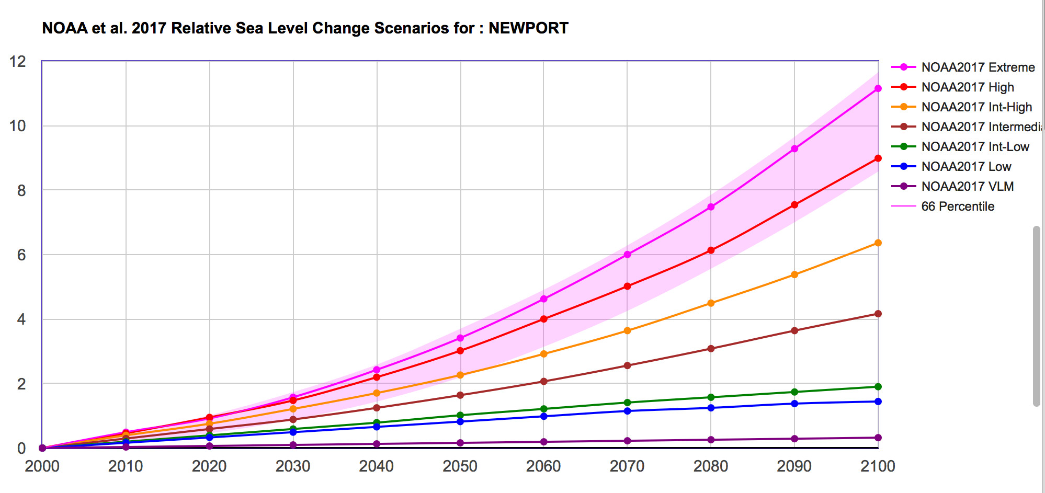
SELECTING SLR SCENARIO (ft)
Sea level change calculator
https://coast.noaa.gov/digitalcoast/tools/curve.html

Slide 8
CASE STUDY 1 NARRAGANSETT BEACH SOUTH PAVILLON SDE BFE -5 FT SLR

Slide 9
CASE STUDY 1 NARRAGANSETT BEACH SOUTH PAVILLON SDE Wave Crest – 5 FT SLR

Slide 10
CASE STUDY 1 NARRAGANSETT BEACH SOUTH PAVILLON FEMA BFE

Slide 11
CASE STUDY 1 SUMMARY NARRAGANSETT BEACH SOUTH PAVILLON
Scenario | BFE [ft] | WAVE CREST [ft] | SURGE [ft] | WATER DEPTH ft] | TOPO [ft]
100-y today | 14.8 (4.5 m) | 1.8 (0.5 m) | 13 ft (4 m) | 6.6 (2 m) | 8.2 (2.5 m)
100-y 2070 NOAA High Scenario 5ft SLR | 23.4 (7.1 m) | 5.4 (1.6 m) | 13 + 5 = 18 ft (5.5 m) | 15.2 (4.6 m) | 8.2 (2.5 m)
FEMA | 15 (4.6 m) | VE ZONE

Slide 12
CASE STUDY 2 CHARLESTOWN BRIDGE NINIGRET-GREEN HILL
How would the bridge be exposed to the “100-year storm if it would occur today?
Water depth, wave elevation, BFE?
If the same storm would occur in 25 years from now, how would it impact the site?
Will the bridge be affected by SLR in 25 year?
https://crc-uri.maps.arcgis.com/apps/MapSeries/index.html?appid=9b85db9b7aaa400cac1a3cb404a96be8

Slide 13
CASE STUDY 2 CHARLESTOWN BRIDGE NINIGRET-GREEN HILL FEMA BFE

Slide 14
CASE STUDY 2 CHARLESTOWN BRIDGE NINIGRET-GREEN HILL SDE BFE
100 Y-STORM SURGE (95% UPPER CONFIDENCE INTERVAL) + WAVE CREST
100-Y DUNE PROFILE BASED ON XBEACH

Slide 15
CASE STUDY 2 CHARLESTOWN BRIDGE NINIGRET-GREEN HILL SDE SURGE
100 Y-STORM SURGE (95% UPPER CONFIDENCE INTERVAL)
BASED ON NAACS DATA

Slide 16
CASE STUDY 2 CHARLESTOWN BRIDGE NINIGRET-GREEN HILL SDE WAVE CREST
WAVE CREST = MEAN 1% HIGHEST WAVE
RESULT OF STWAVE MODEL ON HIGH RESOLUTION GRID (10 m)

Slide 17
CASE STUDY 2 CHARLESTOWN BRIDGE NINIGRET-GREEN HILL SDE WATER DEPTH

Slide 18
CASE STUDY 2 CHARLESTOWN BRIDGE NINIGRET-GREEN HILL SDE BFE - 2FT SLR

Slide 19
CASE STUDY 2 CHARLESTOWN BRIDGE NINIGRET-GREEN HILL SDE WAVE CREST - 2FT SLR

Slide 20
CASE STUDY 2 CHARLESTOWN BRIDGE NINIGRET-GREEN HILL SDE WATER DEPTH - 2FT SLR

Slide 21
CASE STUDY 2 SUMMARY CHARLESTOWN BRIDGE NINIGRET-GREEN HILL
Scenario | BFE [ft] | WAVE CREST [ft] | SURGE [ft] | WATER DEPTH [ft] | TOPO [ft]
100-y today | 13.9 ( 4.2 m) | 0.5 ( 0.15 m) | 13.4 ( 4 m) | 7.5 ( 2.3 m) | 6.4 ( 1.9 m)
100-y in 2045 | 17.3 ( 5.3 m) | 1.9 ( 0.6 m) | 13.4+2(4.7m) | 10.9 (3.3 m) | 6.4 ( 1.9 m)
FEMA | 14 (4.3 m) | A ZONE

Slide 22
CASE STUDY 3 FIELDS POINT WATER TREATMENT PLANT
IS SLR AFFECTING THE VULNERABILITY OF THE SITE? How much?
IS WAVES EXPOSURE A SIGNIFICANT FACTOR IN THE SITE VULNERABILITY? What fraction of surge ?
Fields Point, RI, USA

Slide 23
CASE STUDY 3 FIELDS POINT WATER TREATMENT PLANT SDE

Slide 24
CASE STUDY 3 FIELDS POINT WATER TREATMENT PLANT WAVE CREST

Slide 25
CASE STUDY 3 FIELDS POINT WATER TREATMENT PLANT SURGE

Slide 26
CASE STUDY 3 FIELDS POINT WATER TREATMENT PLANT WATER DEPTH

Slide 27
CASE STUDY 3 FIELDS POINT WATER TREATMENT PLANT SDE - 5FT SLR

Slide 28
CASE STUDY 3 FIELDS POINT WATER TREATMENT PLANT WAVE CREST - 5 FT SLR

Slide 29
CASE STUDY 3 FIELDS POINT WATER TREATMENT PLANT WATER DEPTH - 5FT SLR

Slide 30
CASE STUDY 3 FIELDS POINT WATER TREATMENT PLANT SDE -10 FT SLR

Slide 31
CASE STUDY 3 FIELDS POINT WATER TREATMENT PLANT WAVE CREST - 10 FT SLR

Slide 32
CASE STUDY 3 FIELDS POINT WATER TREATMENT PLANT WATER DEPTH - 10FT SLR

Slide 33
CASE STUDY 3 SUMMARY FIELDS POINT WATER TREATMENT PLANT
Scenario | BFE [ft] | WAVE CREST [ft] | SURGE [ft] | WATER DEPTH [ft] | TOPO [ft]
100-y today | 18 ( 5.5 m) | 0.4 ( 0.1 m) | 17.6 (5.4m) | 9.2 ( 2.8 m) | 8.8 ( 2.7 m)
100-y in 2100 | 24.2 ( 7.4 m) | 1.6 ( 0.5 m) | 17.6+5 (6.9m) | 15.4 ( 4.7 m) | 8.8 ( 2.7 m)
 | 30.1 ( 9.2 m) | 2.5 ( 0.8 m) | 17.6+10(8.4m) | 21.3 ( 6.5 m) | 8.8 ( 2.7 m)
FEMA | 12 (3.7 m) | A ZONE

Slide 34
Other sites
NOAA SLR viewer :
https://coast.noaa.gov/slr/
Sea level change calculator
https://coast.noaa.gov/digitalcoast/tools/curve.html

