Slide 1
Synthetic Design Elevation [SDE] maps Methodology
University OF
Rhode Island
Ocean Engineering
Annette Grilli¹, OCE
M. Spaulding¹, G. Westcott¹ , C. Damon²,
¹ Ocean Engineering, URI
² Environmental Data Center, URI
SDE TRAINING SESSION URI OCTOBER 24 2018

Slide 2
FEMA’FIRM METHODOLOGY RI
HAZARD | METHOD
SURGE | EMPIRICAL BASED ON 3 TIDE GAGES EXTREME VALUE STATISTICAL ANALYSIS MEAN VALUE
WAVE | OFFSHORE : 2-D PHASE AVERAGE MODEL COASTAL + ONSHORE PROPAGATION: 1-D MODEL [WHAFIS] SELECTED TRANSECTS
EROSION | 50 m³ PROTOCOL Empirical (Hallermeier & Rhodes 1989) E =8 T_{r}^{0.4} (m³)
SDS 100-y | SURGE BASED ON EMPIRICAL DATA STEADY STATE MSL AND WAVE CLIMATE NO SEA LEVEL RISE HAZARDS ASSUMED INDEPENDENT 1-D
PROVIDENCE
NEWPORT
NEW LONDON
540 sq.ft [50 m³/m]
EROSION
25 km
University OF Rhode Island
Ocean Engineering

Slide 3
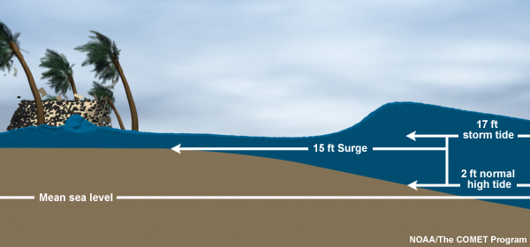
HAZARD: STORM SURGE
HAZARD | FEMA | SDE | WHY?
SURGE | Empirical based on 3 tide gages Extreme value statistical analysis Mean value | Use of NACCS stochastic synthetic storms [Jenssen,2017] Use a suite of fully coupled surge and wave models Stochastic large number of storms Extreme value analysis based on joint probability 95% upper confidence interval | 2-D Larger pool of “possible storms” Could catch grey swans(rare event) Conservative scenario (95% CI)
WAVE
EROSION
SDS 100-y
University OF Rhode Island
Ocean Engineering

Slide 4
HAZARD: WAVES
HAZARD | FEMA | SDE | WHY ?
SURGE
WAVE | Coastal and onshore inundation zone: 1-d model at selected transects | 2-D phase averaged model STWAVE | Continuous Coverage Includes 2-D processes [refraction]
EROSION
SDS 100-y
University OF Rhode Island
Ocean Engineering

Slide 5
HAZARD: EROSION
HAZARD | FEMA | SDE | WHY?
SURGE
WAVE
EROSION STORM TIME SCALE | 50 m³ protocol | 2-D erosion model XBEACH | XBEACH Process based model 2-D Predicts breaching
SDS 100-y
University OF Rhode Island
Ocean Engineering

Slide 6
THE 100-YEAR SYNTHETIC DESIGN STORM (SDS)
HAZARD | FEMA | SDE | WHY?
SURGE | Empirical based on 3 tide gages Extreme value statistical analysis ;Mean value
WAVE | Coastal and onshore inundation zone : 1-d model at selected transects
EROSION | 50 m³ protocol
SDS 100-y | Hazards assumed independent to estimate 1% probability of exceedance of local storm parameters Probability analysis based on past observations Steady state MSL and wave climate ; No SLR Processes in 1-D | Hazards assumed dependent (joint probability) Synthetic storms expends the range of conditions for storm generation Include SLR in projected scenario 2-D processes included | More rigorous methodology Minimize uncertainty Increase probability catching Grey Swans
University OF Rhode Island
Ocean Engineering - Grilli et al. 2018

Slide 7
STATIC WATER LEVEL (STWL) TIDE-SURGE
SURGE: “Rise in seawater during storm due to wind pushing water onshore” (NOAA)
NAACS SAVE POINTS
U.S. CORPS OF ENGINEERS
JENSEN ET AL.,2017
DATA SOURCE
NACCS save points
MODEL
coupled ADCIRC-STWAVE
200 m resolution
INCLUDE
Tide
Wave set-up
University OF Rhode Island
Ocean Engineering -

Slide 8
100-Y STWL
Extreme value analysis at each save points
“100-y surge” [STWL]
Mapping across the inundation zone
Spatial variation , slope S-N ?
Balance wind/friction
Wave set-up
3
4
5
6
m
University OF Rhode Island
Ocean Engineering

Slide 9
WAVE IN SDE
STWAVE
STeady State Spectral WAve Model (Smith, Sherlock and Resio, 1991)
2-D PHASE AVERAGE MODEL
WAVE ACTION CONSERVATION
Linear wave theory
Refraction and shoaling
Non-linear Energy Transfer due to Wave Interaction (Hasselman ;1961)
Wave breaking / Mitche criterion (depth, wave steepness)
(Battjes and Jenssen, 1978)
WAVE CREST (1%)
ASSUMING RAYLEIGH DISTRIBUTION
WC= H_{S}*0.7*1.66
University OF Rhode Island
Ocean Engineering

Slide 10
WAVE MODELING METHODOLOGY
MODEL STWAVE
COMPUTATIONAL GRID :
Discretization: 10 m
10 X 15 km
Boundary +Initial Conditions from NACCS study
100-year wave spectral parameters
STWL [Tidal Surge] from NACCS 95% CI
From coupling ADCIRC-STWAVE
SLR linearly superimposed on STWL
3 South shore grids; 1 bay grid
Spectrum Type | Location Depth(m) | Hs (m) | Tp (s)
TMA | 43 | 7 | 20
University OF Rhode Island
Ocean Engineering

Slide 11
WAVE MODELING NARRAGANSETT BAY
SOUTH WIND 35 m/s
NORTH EAST WIND 35 m/s
University OF Rhode Island
Ocean Engineering

Slide 12
WAVE MODELING SOUTH SHORE
INUNDATION (M)
WAVE CREST (M)
University OF Rhode Island
Ocean Engineering

Slide 13
WAVE MODELING SOUTH SHORE
ADDITIONAL ELEVATION IN WAVE CREST DUE TO DUNE EROSION
University OF Rhode Island
Ocean Engineering

Slide 14
MODELING EVENT SCALE EROSION WITH XBEACH
wave forcing
XBeach (Roelvink, 2009)
Morphodynamic
Model
Wave module
Flow module
water level, current
bed level
time
water level, current
Morphology module
Sediment module
sediment transport
University OF Rhode Island
Ocean Engineering

Slide 15
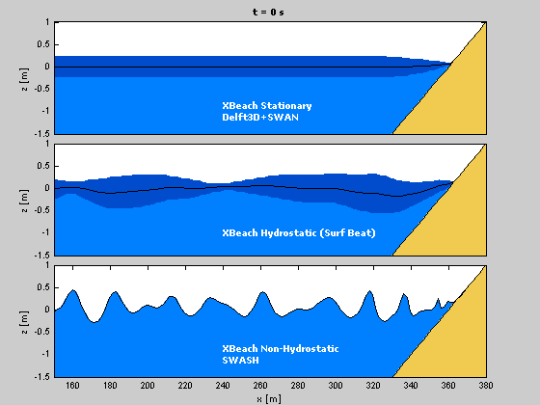
MODELING EVENT SCALE EROSION
XBEACH 3 MODES
STATIONARY
SURF-BEAT
NON-HYDROSTATIC
DELTARES 2018

Slide 16
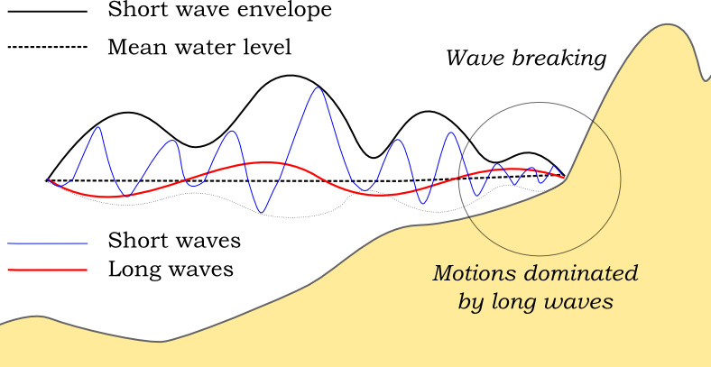
XBEACH WAVES
DELTARES 2018
ROELVINK, 2009
DELTARES 2018

Slide 17
SOUTH SHORE BARRIER BEACHES MOVIE’ SITES
Green Hill
Matunuck
XBEACH
Surfbeat
Mode
Charlestown
M2
M1
Weekapaug
M3
M5
M4
Winnapaug
University OF Rhode Island
Ocean Engineering

Slide 18
M1 EAST MATUNUCK 100-y STORM EROSION
University OF Rhode Island
Ocean Engineering

Slide 19
VEGETATION EFFECT ON DUNE EROSION
VEGETATED DUNE
13 h after peak of the storm [High tide]
5
0
BARE DUNE
13 h after peak of the storm [High tide]
5
0
University OF Rhode Island
Ocean Engineering

Slide 20
VEGETATION EFFECT ON DUNE EROSION
FEMA
MODEL - VEGETATION
MODEL – BARE DUNE
 | AVERAGE ERODED VOLUME (m³/m)
FEMA | 50
MODEL VEGETATION | 46
FEMA 20
University OF Rhode Island
Ocean Engineering

Slide 21
EROSION SPATIAL VARIABILITY ALONG THE SHORELINE
Bathymetry (NAVD88)
Dune crest (m) BEFORE AFTER
University OF Rhode Island
Ocean Engineering

Slide 22
CHARLESTOWN NO SLR BFE NAVD88 (m)
0 2 4 6 8 10 12 m
University OF Rhode Island
Ocean Engineering

Slide 23
CHARLESTOWN 2ft SLR BFE NAVD88 (m)
0 2 4 6 8 10 12 m
University OF Rhode Island
Ocean Engineering

Slide 24
CHARLESTOWN 5ft SLR BFE NAVD88 (m)
0 2 4 6 8 10 12 m
University OF Rhode Island
Ocean Engineering

Slide 25
CHARLESTOWN 7ft SLR BFE NAVD88 (m)
0 2 4 6 8 10 12 m
University OF Rhode Island
Ocean Engineering

Slide 26
CHARLESTOWN 10ft SLR BFE NAVD88 (m)
0 2 4 6 8 10 12 m

Slide 27
SUMMARY METHODOLOGY SDE BFE GENERATION
SLR
STWL
LOCATION
EROSION
DEM
WAVE
BFE
FOR SLR SCENARIO
Select Sea Level Rise [SLR} estimate for design life
“100-y surge” estimated from extreme value analysis at NACCS save points
Narragansett Bay
Low waves
Little erosion
NO
INTACT
STWAVE 2-D MODEL
Southern Shoreline
Large wave
Significant dune erosion
XBEACH
2-d MODEL
ERODED
STWAVE 2-D MODEL
TOTAL STWL=SLR + STWL
NAACS WAVE SPECTRAL
PARAMETERS
LOCAL WIND
University OF Rhode Island
Ocean Engineering

Slide 28
REFERENCES
Grilli, A., and Spaulding, M. L., Oakley, B. A. and Damon, C., 2017. Mapping the coastal risk for the next century, including sea level rise and changes in the coastline: application to Charlestown RI, USA. Natural Hazards
https://doi.org/10.1007/s11069-017-2871-x
Grilli, A.R., Spauding, M.L., Schambach, L., Smith, J. and Bryant, M., 2016. Comparing Inundation Maps Developed Using WHAFIS and STWAVE: A Case Study in Washington County, RI. Proceeding of the Coastal disaster Conference, September 9-11,2015, Boston.
https://ascelibrary.org/doi/abs/10.1061/9780784480304.016
Schambach, L., Grilli, A.R., Grilli, S., Hashemi, R., King, J., 2017. Assessing the impact of extreme storms on barrier beaches along the Atlantic coastline: Application to the southern Rhode Island coast . Coastal Engineering https://doi.org/10.1016/j.coastaleng.2017.12.004
Spaulding, M.L., Grilli, A., Damon, C., Crean, T., Fugate, G., Oakley, B.A. and Stempel, P., 2016. STORMTOOLS: coastal environmental risk index (CERI). Journal of Marine Science and Engineering, 4(3), p.54
https://doi:10.3390/jmse4030054
Wescott, W., 2018. Predicting 100-year storm wave’s runup for the coast of Rhode Island using a fully nonlinear model. Master thesis. University of Rhode Island. July 2018.
University OF Rhode Island
Ocean Engineering

